Slide 1
CIVIL vs. CRIMINAL PROCEDURE
terminology; parties; cases; similarities; differences

Slide 2
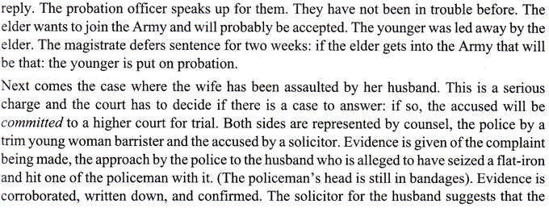

Slide 3
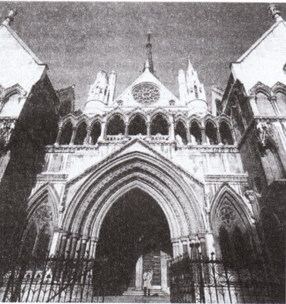
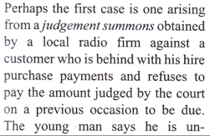
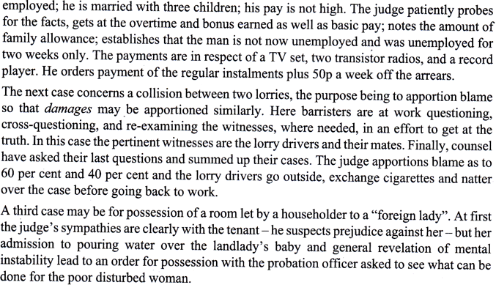

Slide 4
Complete the chart with appropriate word forms
NOUN | VERB | ADJECTIVE
enforcement
 | enact
 |  | scrutinized
acquital
 | indict
 |  | ratified
proposal
 | suspect
 |  | committed
sentence
 | investigate
 |  | convicted
accusation
 | appeal

Slide 5
Complete the chart with appropriate word forms
NOUN | VERB | ADJECTIVE
enforcement | enforce | enforced
enactment | enact | enacted
scrutiny | scrutinize | scrutinized
acquittal | acquit | acquitted
indictment | indict | indicted
ratification | ratify | ratified
proposal | propose | proposed
suspect / suspicion | suspect | suspected
committal | commit | committed
sentence | sentence | sentenced
investigation | investigate | investigated
convict / conviction | convict | convicted
accusation | accuse | accused
appeal / appellation | appeal | appealed
suspect

Slide 6
Complete the chart with the following words. Some words may be used more than once.
legal natural offender injured state/public family injuring
PROCEDURE | INITIATING PARTY | RESPONDENT
CRIMINAL | prosecutor ( __________________ attorney) | defendant (alleged ______ )
CIVIL | claimant ( ___________________ party) | defendant (alleged ______ party)
FAMILY | petitioner ( ______ member) | respondent (family ______ )
COMMERCIAL | claimant ( ______ person) | defendant ( ______ person)
ADMINISTRATIVE | claimant ( ______ or ______ person) | defendant ( ______ authority)
APPELATE | appellant | appellee

Slide 7
Complete the chart with the following words. Some words may be used more than once. - Key:
legal natural offender injured state/public family injuring
PROCEDURE | INITIATING PARTY | RESPONDENT
CRIMINAL | prosecutor (state/public attorney) | defendant (alleged offender )
CIVIL | claimant ( injured party) | defendant (alleged injuring party)
FAMILY | petitioner ( family member) | respondent (family offender)
COMMERCIAL | claimant ( legal person) | defendant ( legal person)
ADMINISTRATIVE | claimant ( natural or legal person) | defendant ( public authority)
APPELATE | appellant ( natural or legal person) | appellee ( natural or legal person)

