Slide 1



Slide 2
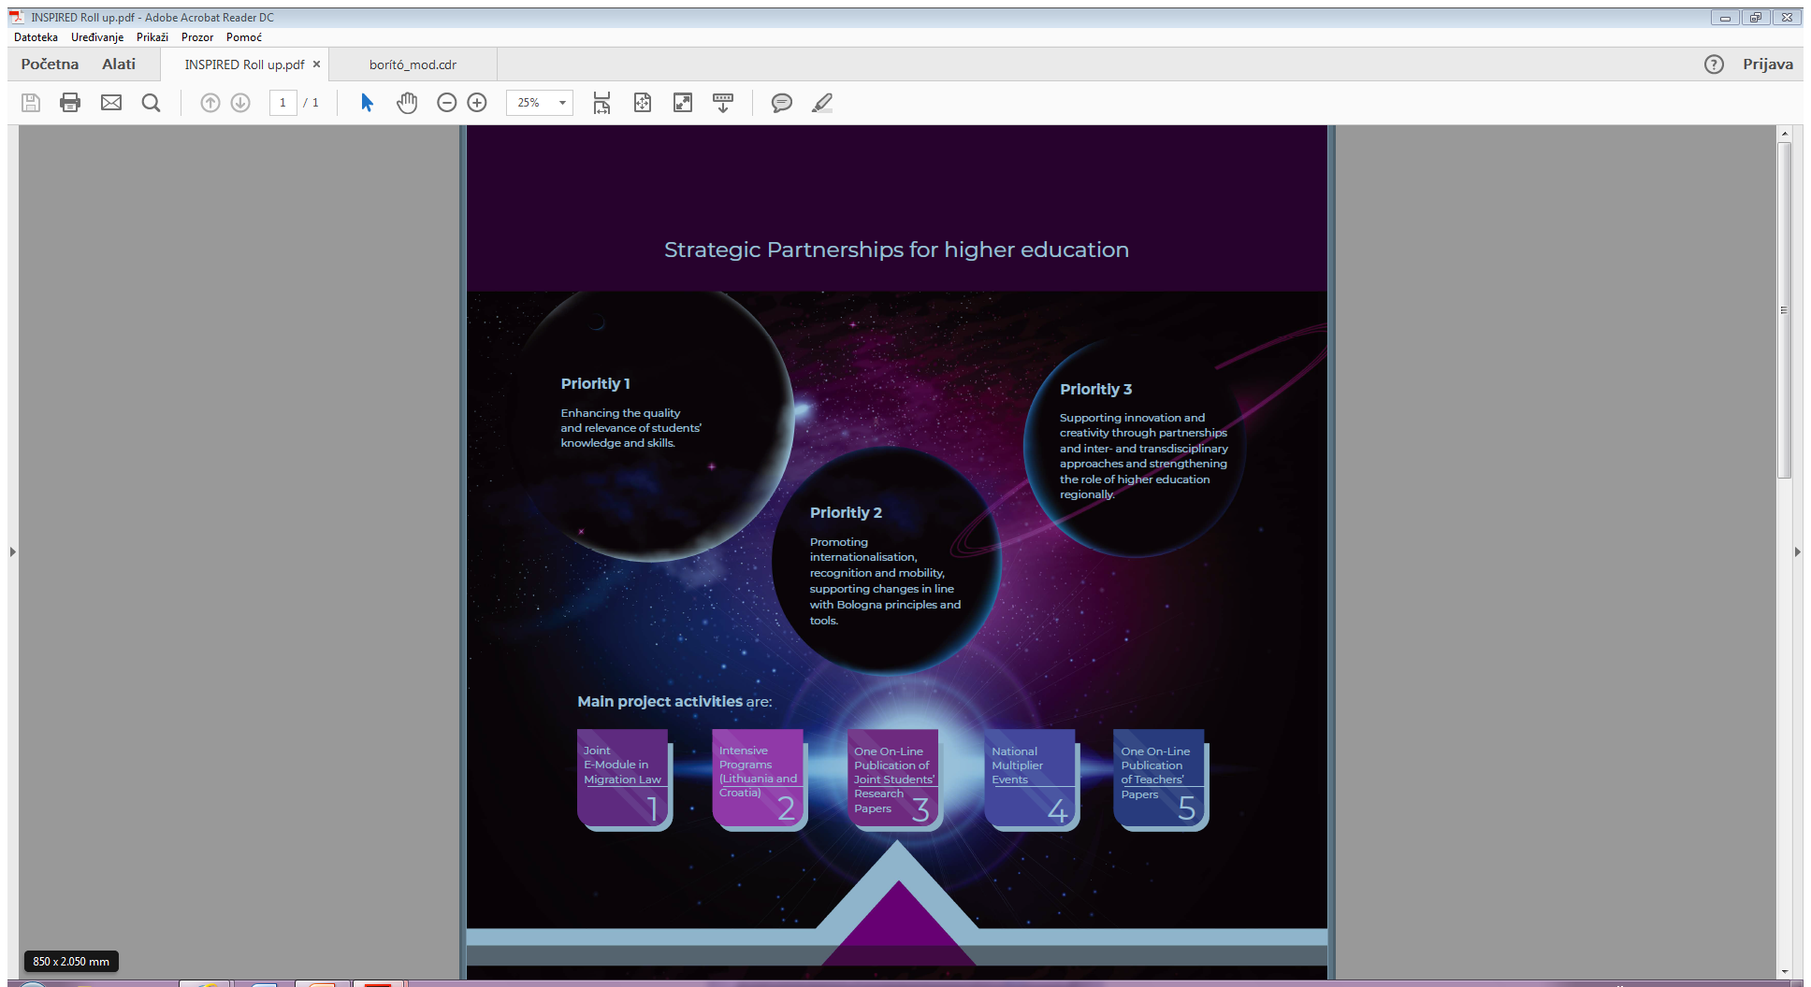








Slide 3
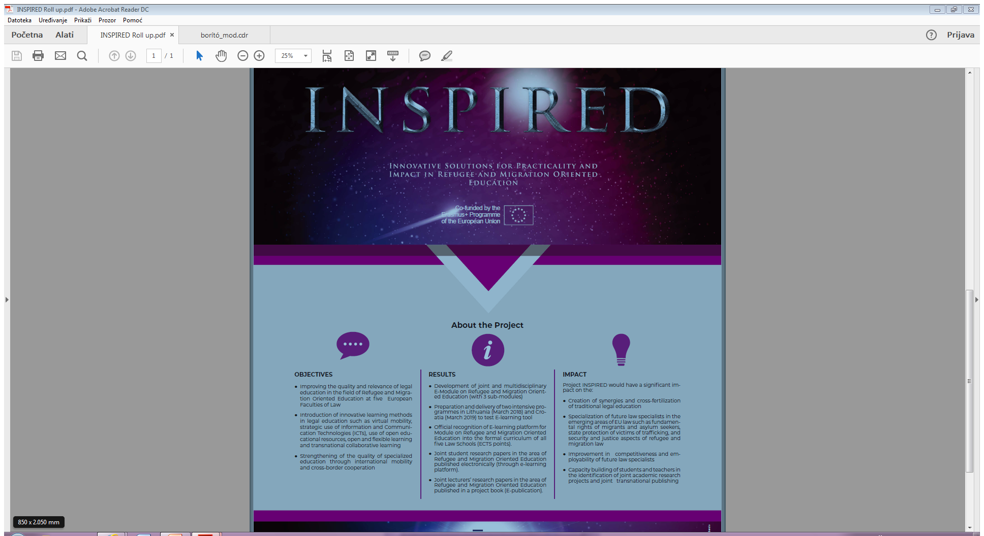

Slide 4
1st IP LITHUANIA MARCH 2018
18 students and 3 teachers IH (Holland)
16 students and 2 teachers PRAVOS (Croatia)
15 students and 2 teachers UP (Hungary)
15 students and 4 teachers MRU (Lithuania)
11 students and 2 teachers LSBU (UK)
14 Ulster (UK)
89 students
13 teachers
6 Universities

Slide 5
2nd IP CROATIA MARCH 2019
21 students and 4 teachers MRU (LI)
17 students and 2 teachers UP (HU)
16 students and 2 teachers PRAVOS (HR)
9 students and 3 teachers LSBU (UK)
63 students
11 teachers
4 Universities

Slide 6
6 PROJECT MEETINGS
October 2017 OSIJEK
February 2018 ROTTERDAM
June 2018 LONDON
November 2018 BELFAST
February 2019 LONDON
June 2019 VILNIUS

Slide 7
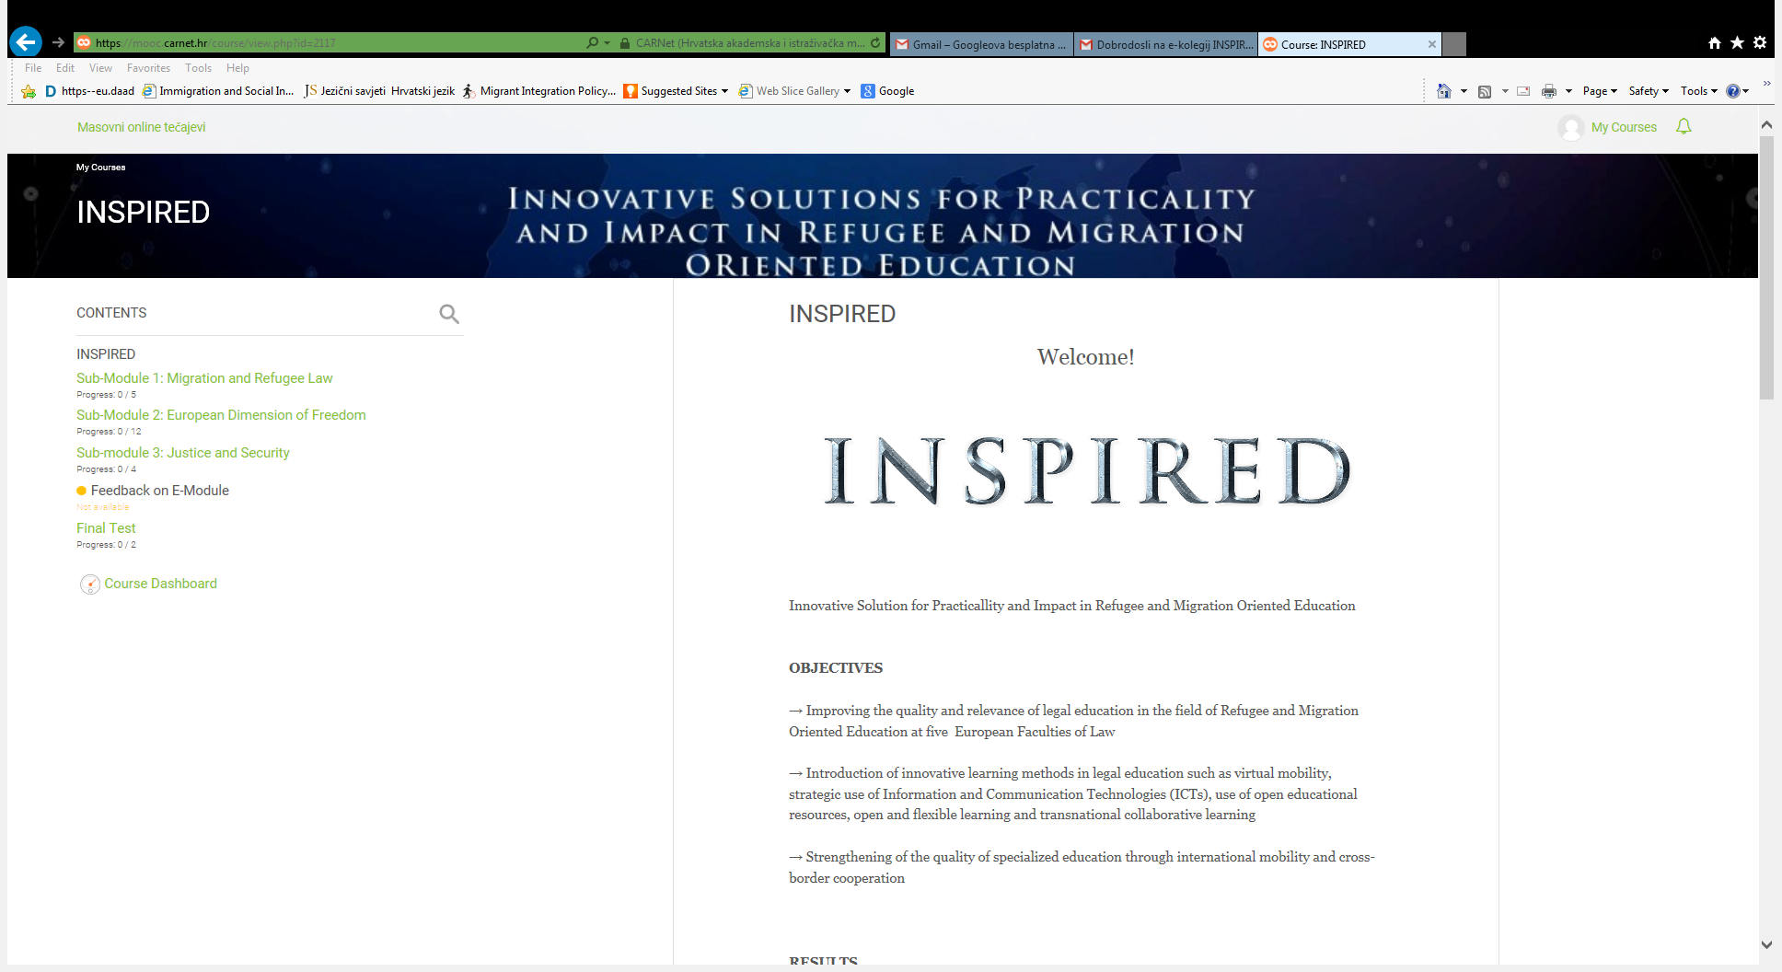

Slide 8
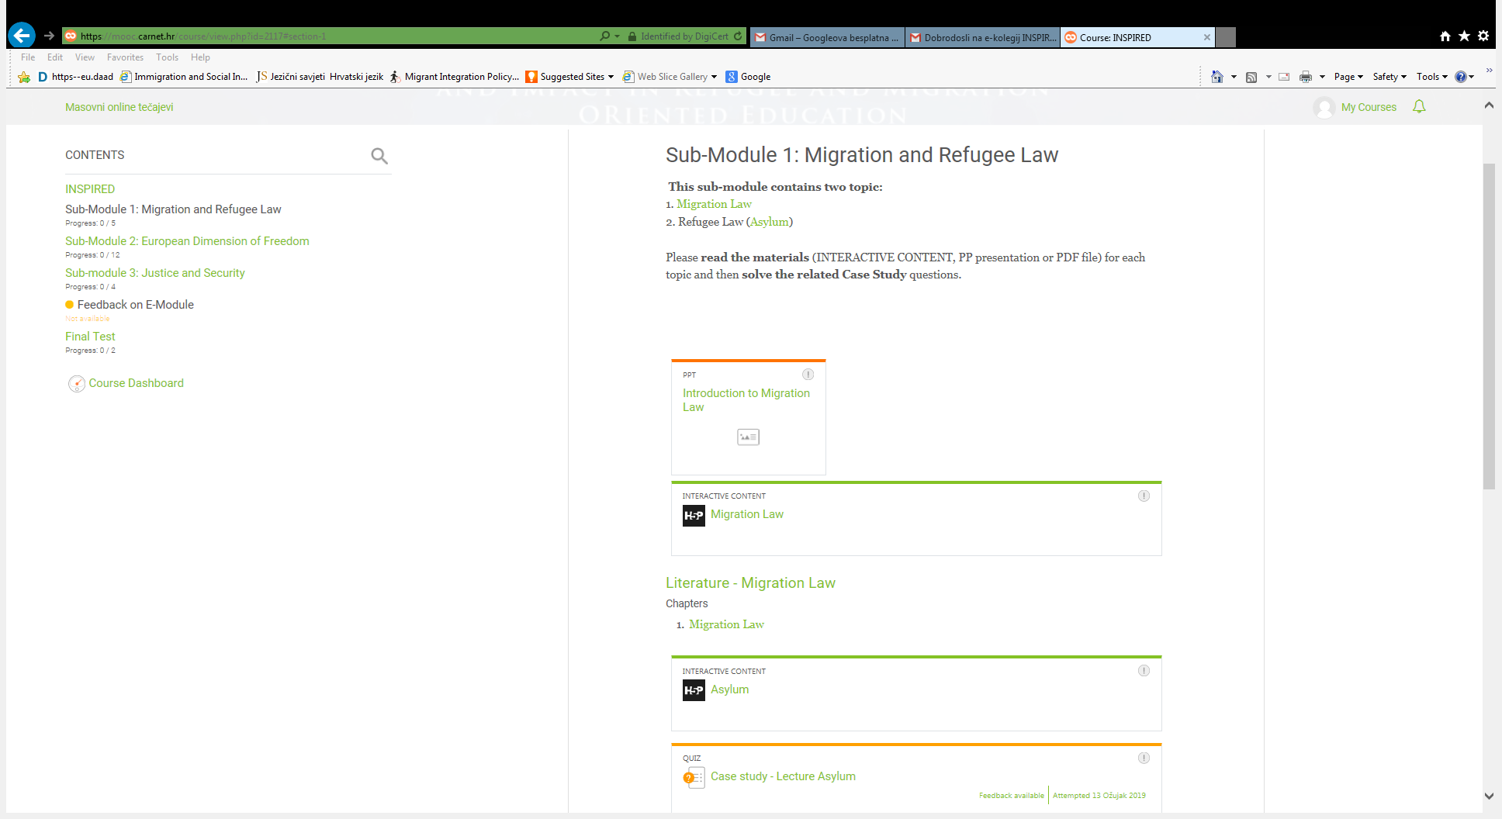

Slide 9
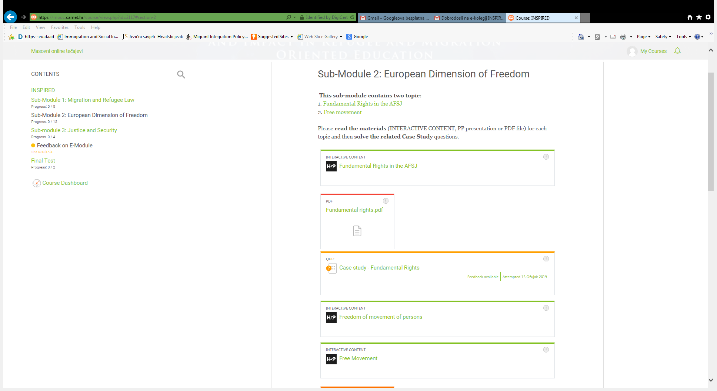

Slide 10
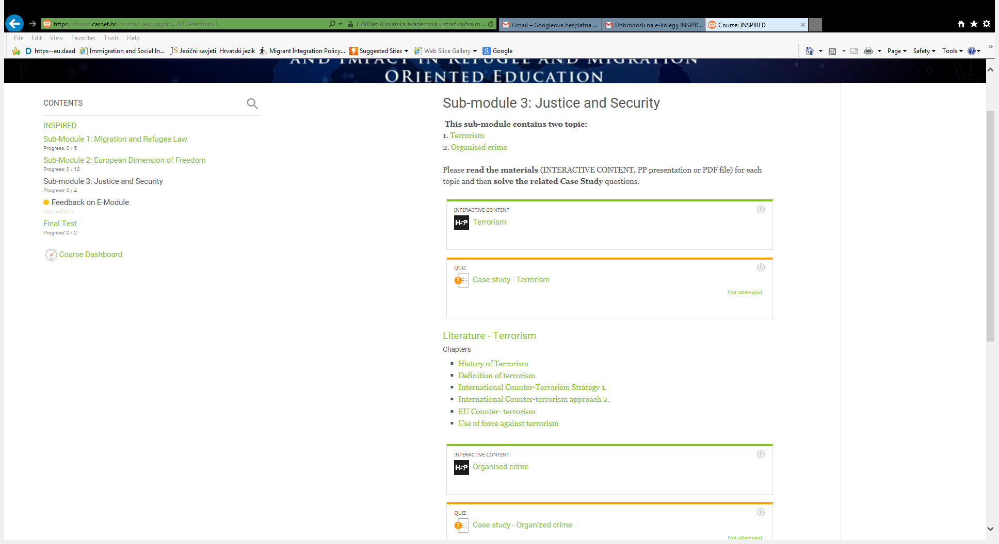

Slide 11
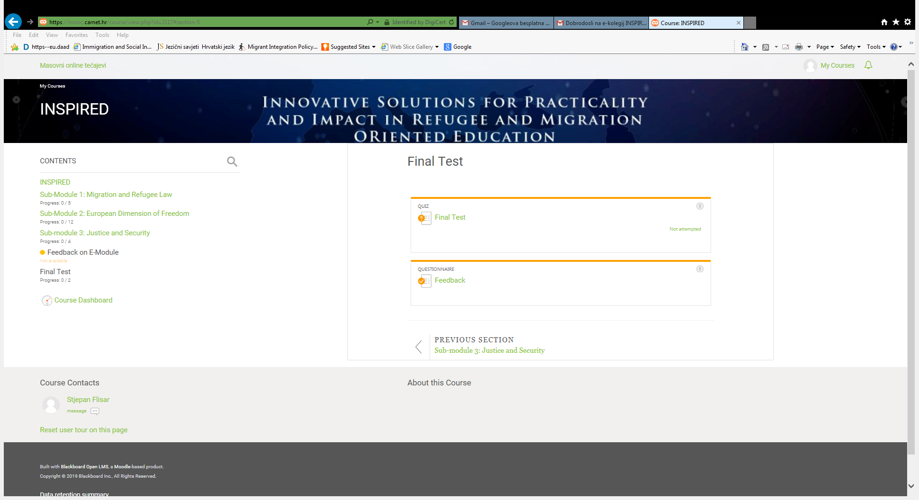

Slide 12
Project book I
EU JUSTICE AND HOME AFFAIRS RESEARCH PAPERS IN THE CONTEXT OF MIGRATION AND ASYLUM LAW
12 authors
158 pages
9 papers

Slide 13
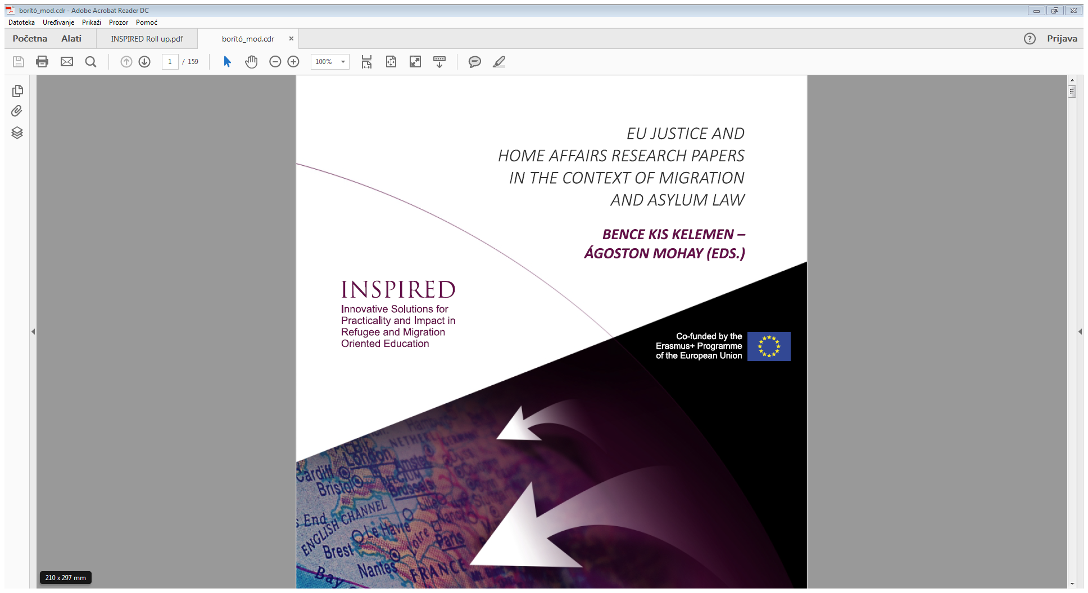

Slide 14
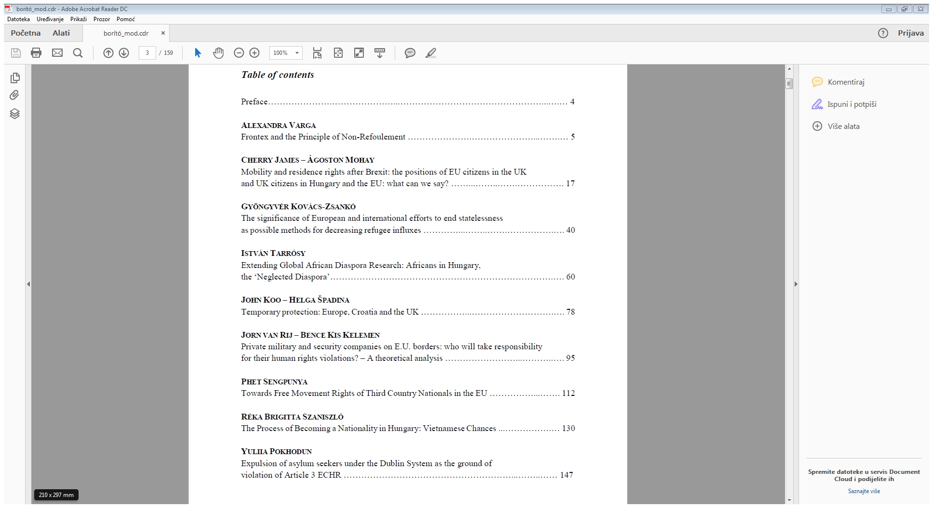

Slide 15
Project book II
STUDENT RESEARCH PAPERS ON JUSTICE AND HOME AFFAIRS IN THE EUROPEAN UNION
3 Chapters:
Asylum and migration
Free movement and fundamental rights
Combating terrorism and organized crime
17 papers
11 joint research papers
(2-5 students)
183 pages
42 students

Slide 16
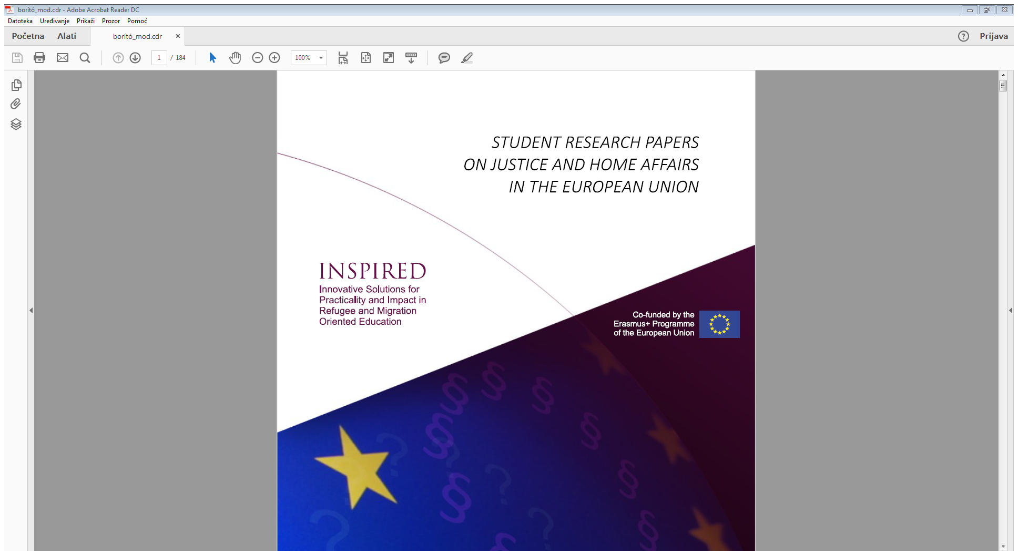

Slide 17
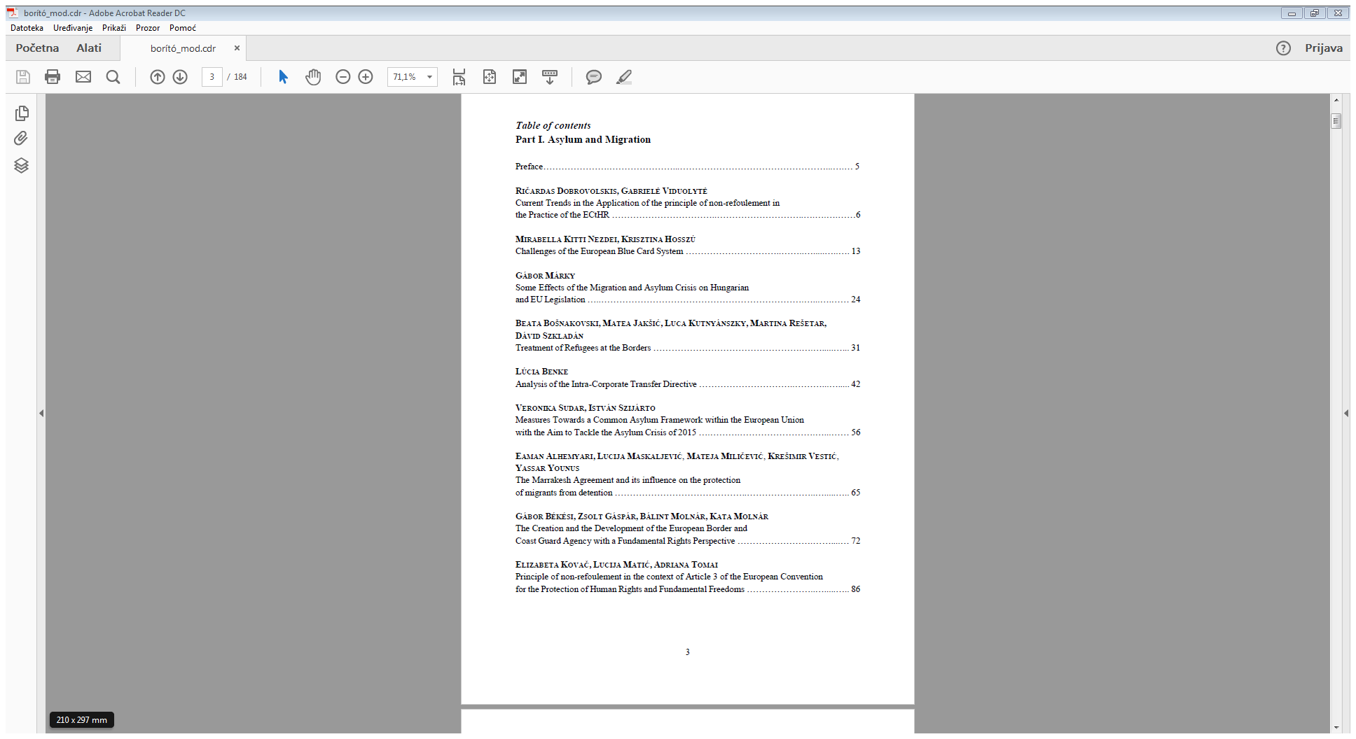

Slide 18
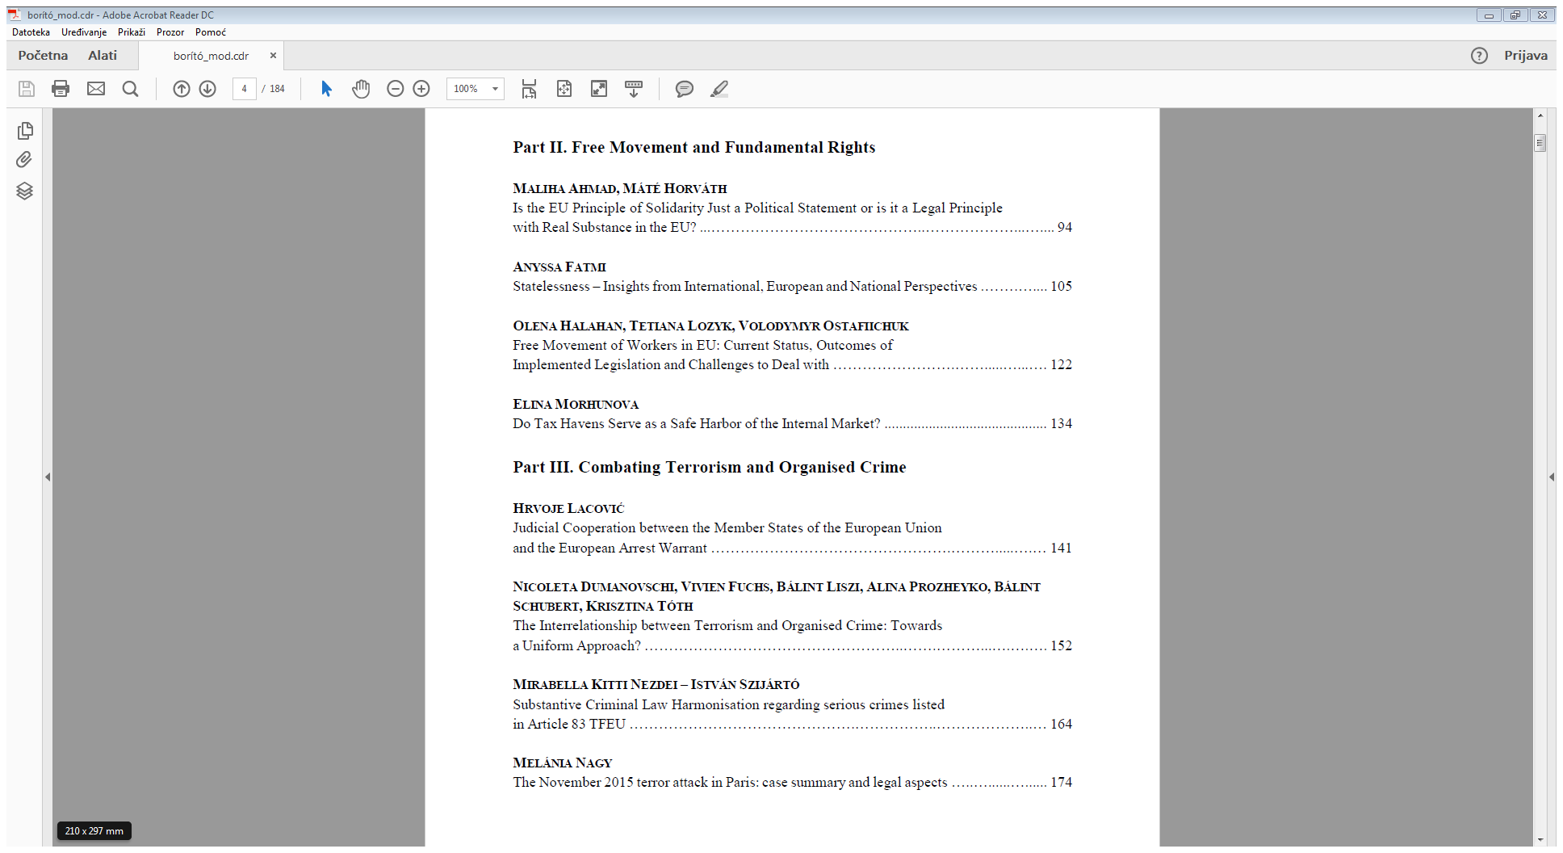

Slide 19



PROJECT VISIBILITY

Slide 20
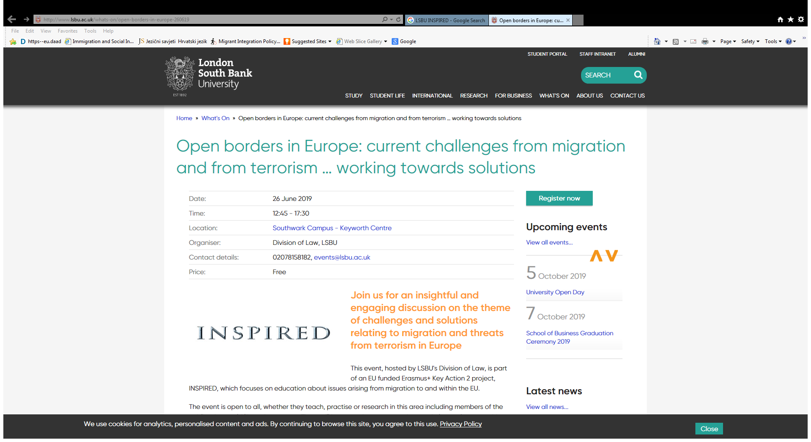

Slide 21
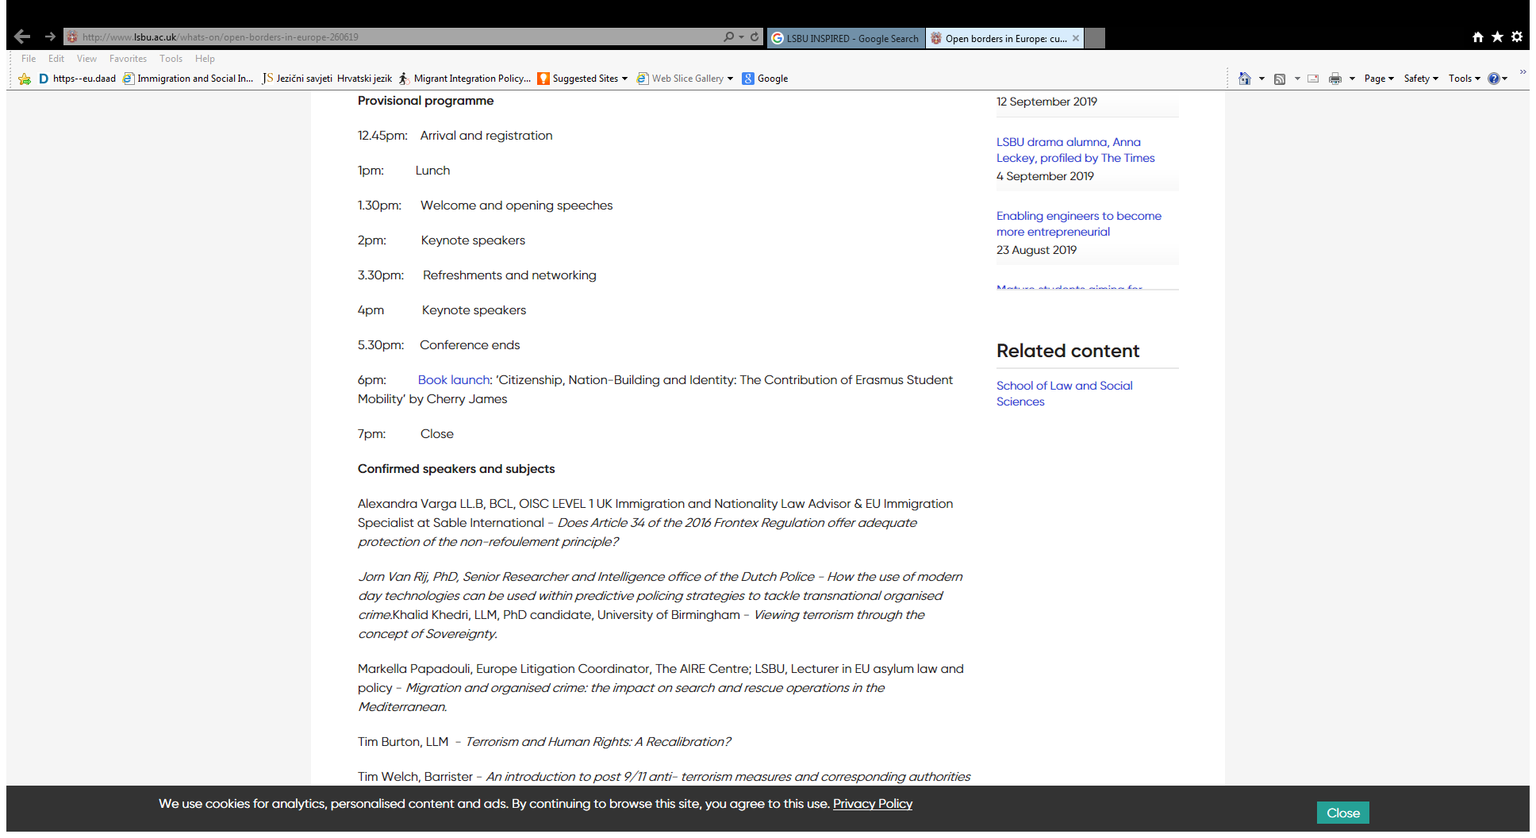

Slide 22
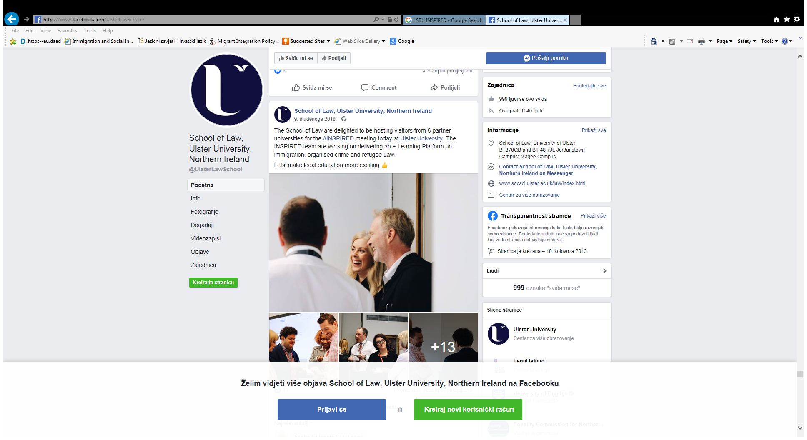

Slide 23
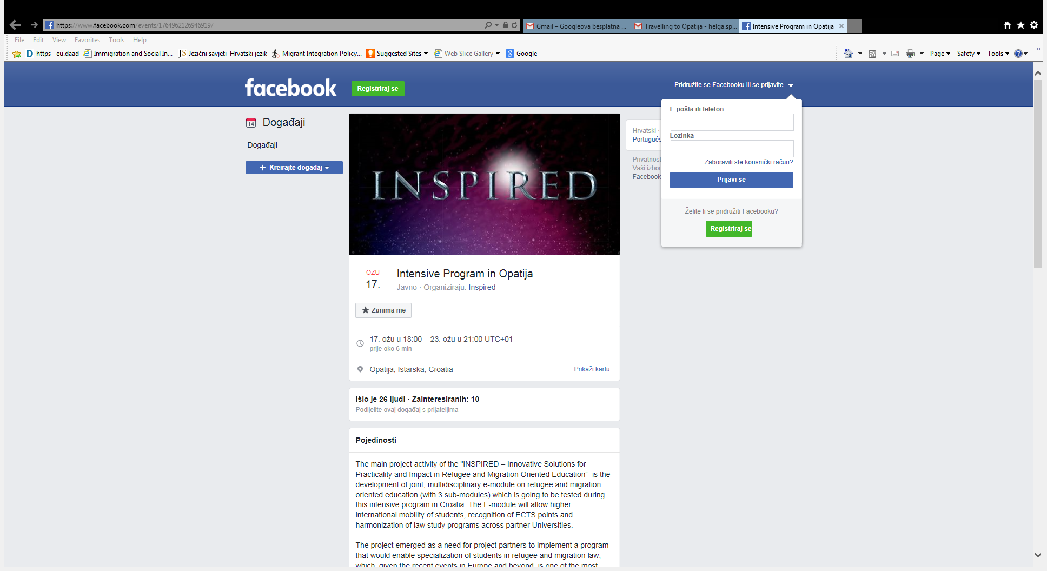

Slide 24
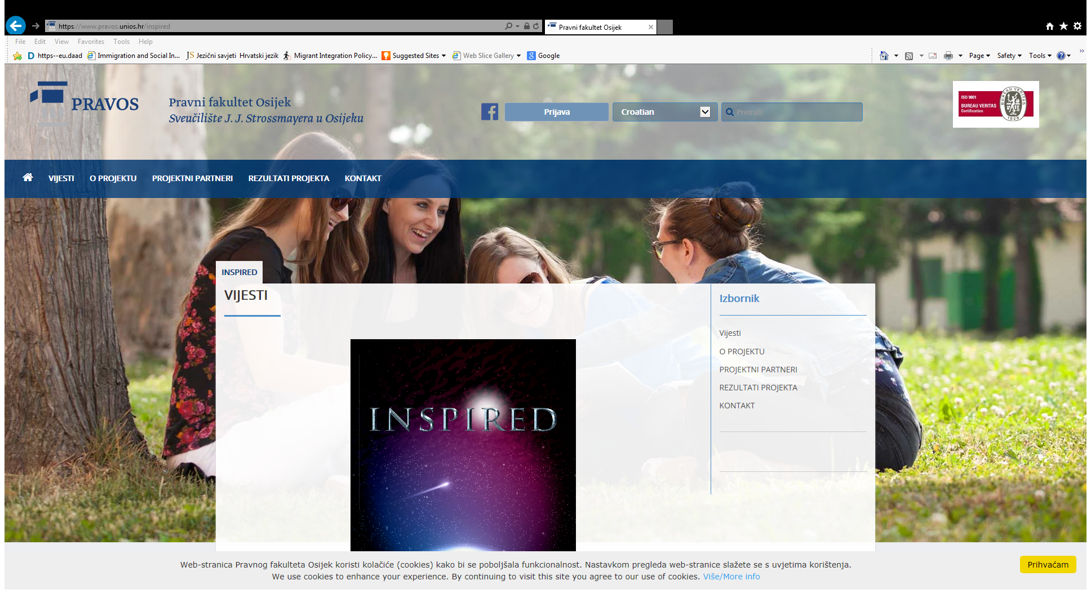

Slide 25
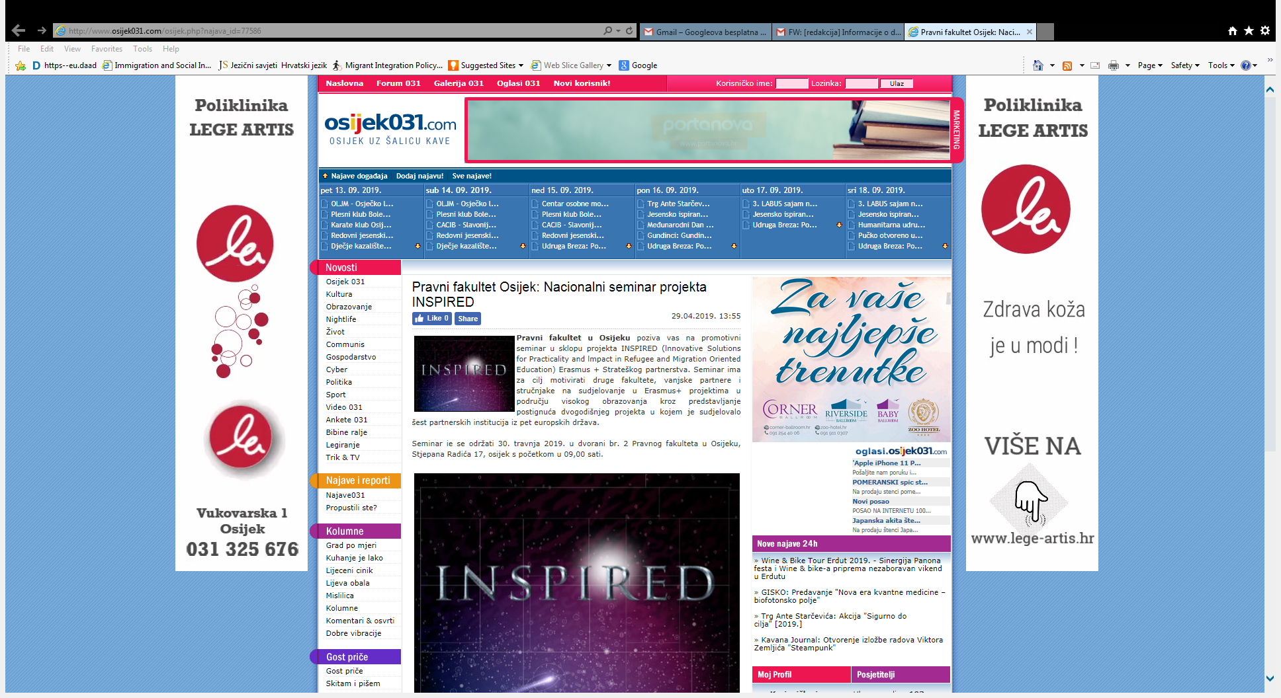

Slide 26


