Slide 1
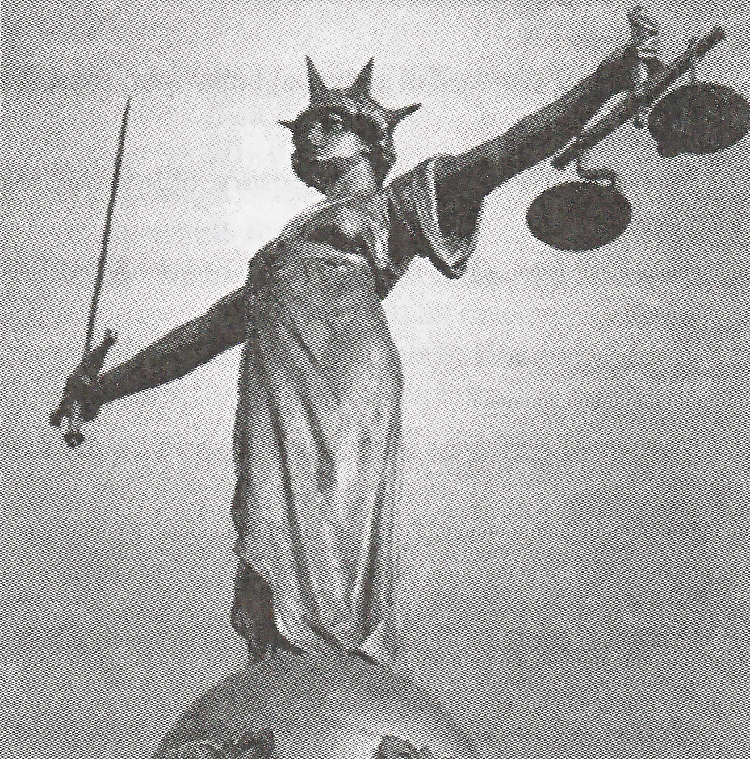
The most common definition of the law in English text books is, „rules of conduct imposed by a state upon its members and enforced by courts.”

Slide 2
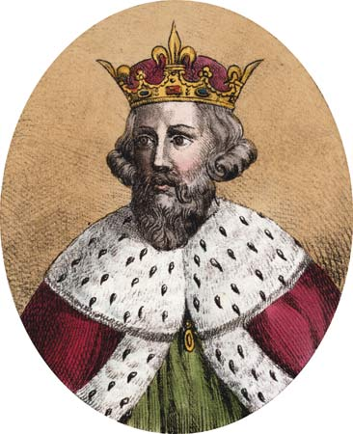
Common law is the body of customary law, based upon judicial decisions and embodied in reports of decided cases, that has been administered by the common-law courts of England since the Middle Ages.
Early English law based on the example of the laws of Germanic people of northern Europe.

Slide 3
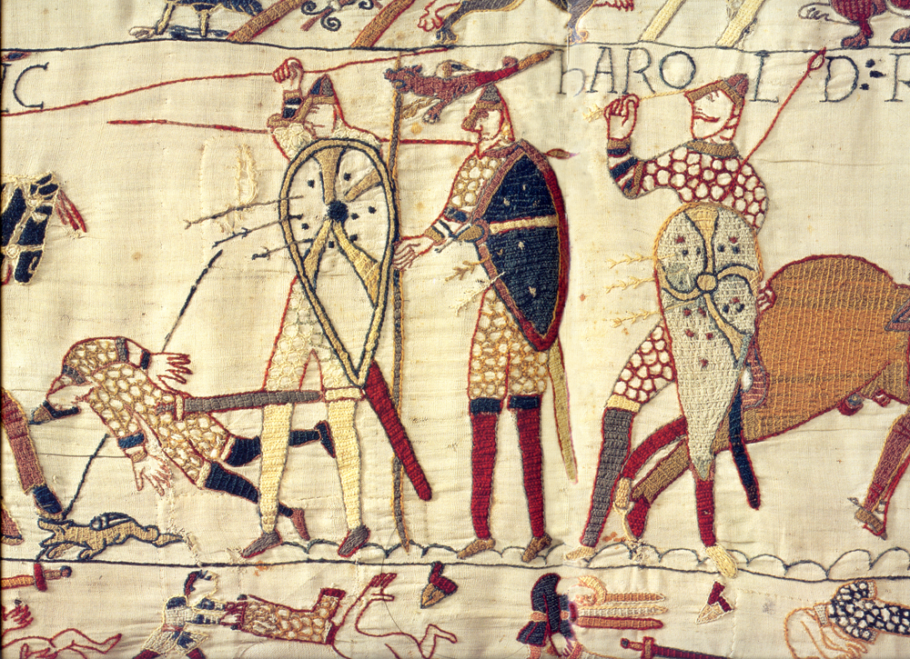
The common law of England was largely created in the period after the Norman Conquest of 1066 and it gradually replaced the Anglosaxon law.

Slide 4
In the Continental law civil procedure is found in codes;
in the Common legal system it is found in rules of court made under statutory powers.
Historically, in the Common legal system civil procedure lawsuits included a jury and a judge. The matter of law was reserved for the decision of the judge and the matters of fact for the jury.
Continental Law is largely contained in written codes
Common Law (especially early law) is largely unwritten

Slide 5
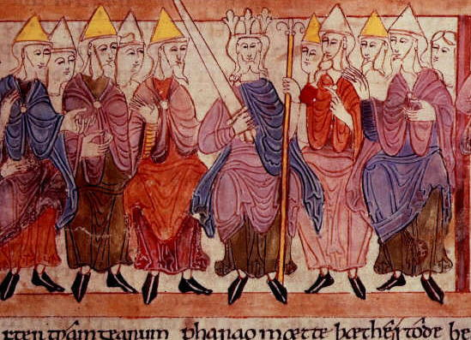
Curia Regis, the king's feudal council to which he summoned his tenants in chief, the great barons, and the great prelates

Slide 6
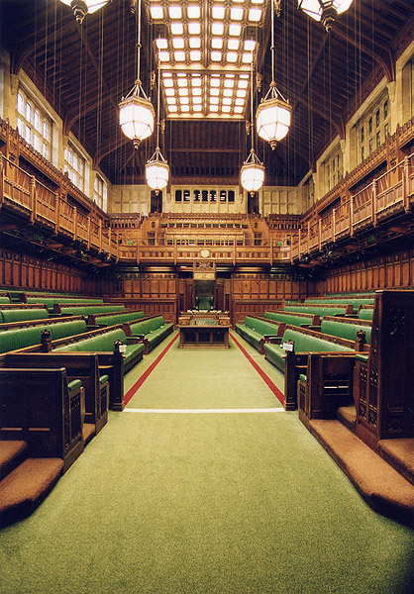
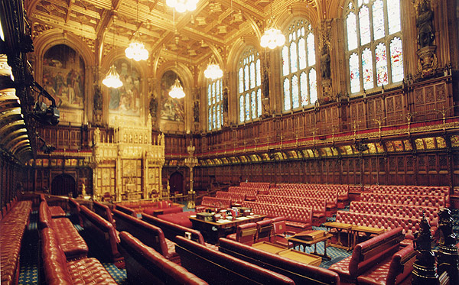
THE HOUSE OF COMMONS
THE HOUSE OF LORDS

Slide 7
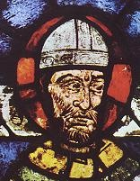
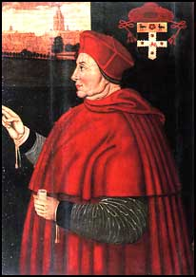
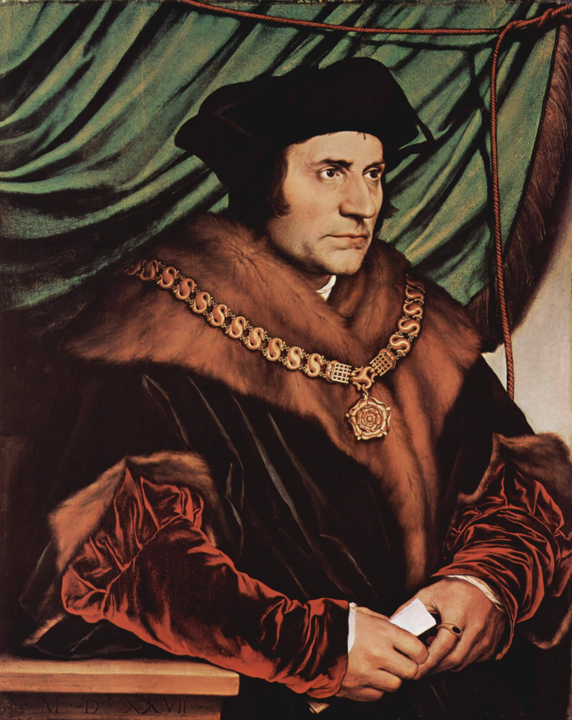
Thomas Becket
Thomas Wolsey
Thomas More

Slide 8
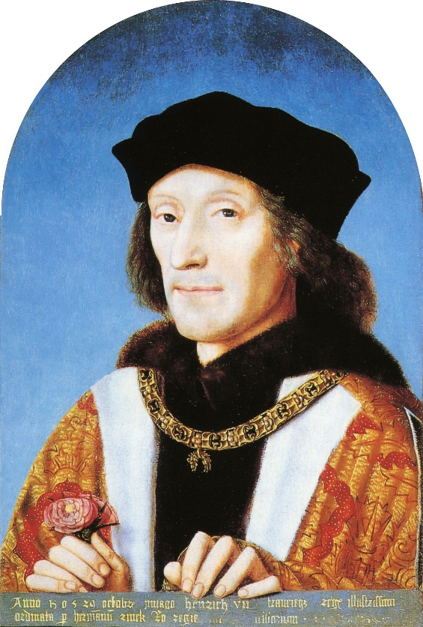
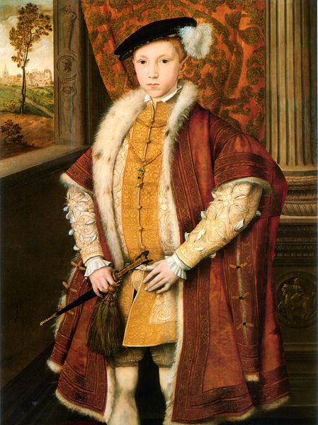
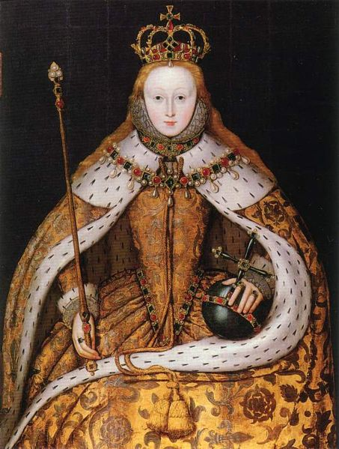
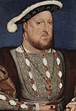
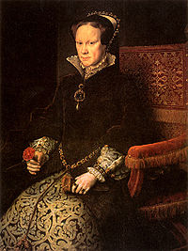
Henry VIII
- English Renaissance
- English Reformation
- Wars against France
and Scotland
- later sides with Pope
and Roman Emperor
CharlesV against France
- Infamous for his 6 wives
→ breach with Rome and
Spain
Mary I of England –
“Bloody Mary”
Seized power from Lady
Jane Grey after 9 days
- 1st English Queen in her
own right
- restored Catholicism
- Persecuted Protestants
→ Bloody Mary
-married Phillip II of Spain
- opposed by Parliament
Henry VII
Ended the War of Roses
Founder of the dinasty
Improved administration
and increased revenue
Peace with France and
the Netherlands
- Connections with Spain
through marriage
Elizabeth I –
“Virgin Queen”
- Succeeded Mary
- Supported commerce
and arts - Elizabethan Age
- restored Protestantism
- Transformed England into a naval force
- Prepared the ground for the future position of England as world power No 1
Edward VI
became king at the age of 9
effectively introduced protestantism
actual power in the hands of regents
appointed Lady Jane Grey as his heir
died 1553 aged 15

Slide 9
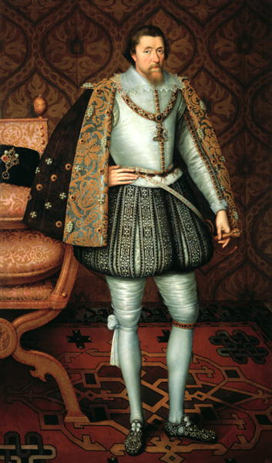
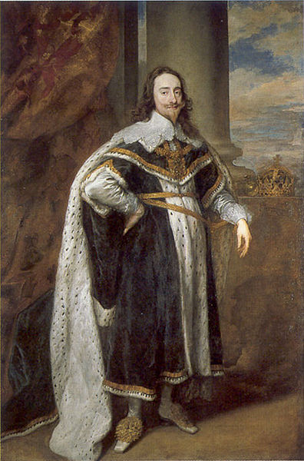
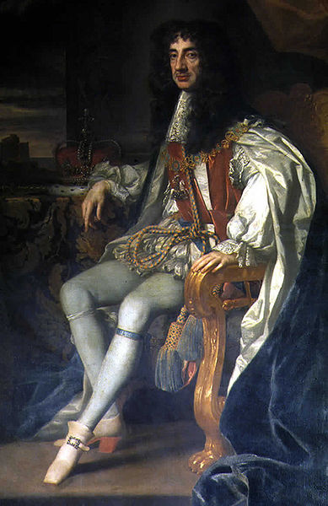
James VI of Scotland
→ James I of England
Charles I of England
Charles II of England

Slide 10
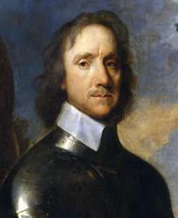
The Commonwealth of England
(aka Cromwellian Interregnum)
Council of State
and
Oliver Cromwell
(1599-1658)
👉 Lord Protector
of
England, Scotland and Ireland

Slide 11
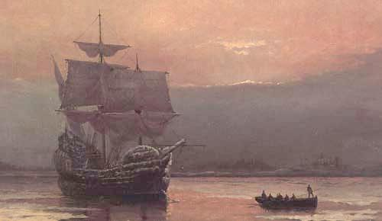
The Mayflower
Pilgrim Fathers
Virginia
Plymouth 1620
Thanksgiving

Slide 12
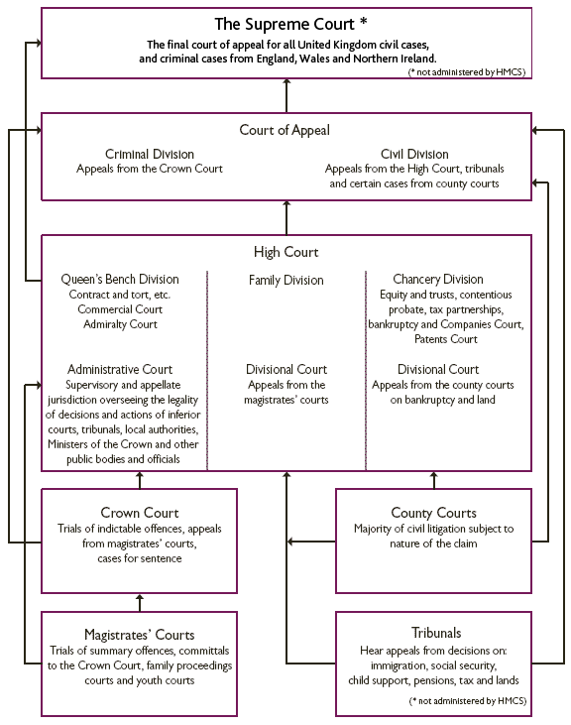
The Court Structure of Her Majesty's Courts Service
(HMCS)
Tribunals
Civil Courts
Criminal Courts
Appelate Courts
Supreme Court
Court of European Justice

Slide 13
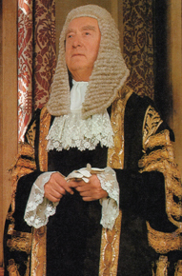
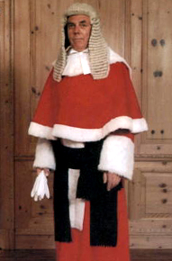
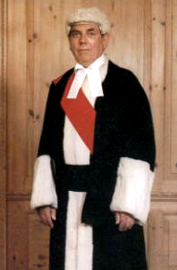
The Lord Chancellor
A high court judge
A lower court judge

Slide 14
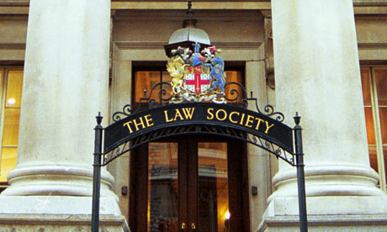

Slide 15
