Slide 1
THE GROWTH OF UNIVERSAL SUFFRAGE IN THE UK
TIMELINE
1265 | Parliament established. It contains 2 chambers. 'the Lords' - unelected aristocrats. and 'the Commons‘- (MPs) are smaller landowners elected only by male landowners.
1642 1660 | English Civil War between the Parliament and the King for control of the state. King Charles I is executed and England is briefly a Republic. In 1660 the monarchy is restored, but it never regains its power. Prime Minister, chosen by Parliament has the most influence.
1707 | Act of Union unites England/Wales and Scotland ⇒ Great Britain
1800 | The United Kingdom is formed.
1819 | The Peterloo Massacre – mass demonstration in favour of universal male suffrage is attacked by troops, 15 people killed.

Slide 2
1832 | Great Reform Act. Before, only landowners could vote for MPs (1 in 7 men, a total of 440,000 people). After 1832, the male urban middle classes gain the vote (1 in 5 men - 650,000 people).
1867 | Second Reform Act extends the vote to skilled urban male working class (1 in 3 men).
1884 | Third Reform Act gives vote to working class men in the countryside (2 out of 3 men).
1918 | Representation of the People Act – gives right to vote to almost all men over 21 and to women over 30 years of age.
1928 | Effectively all women and men over 21 now have the vote.

Slide 3
https://youtu.be/9Yr1Dj8jKv8 - Short History of Representation (animated)
https://www.youtube.com/watch?v=RAMbIz3Y2JA
- An introduction to Parliament (animated)
https://youtu.be/ENIW7i48xHA - Tour of the House of Commons
https://youtu.be/_sLZBWcPklk - Tour of the House of Lords
https://www.youtube.com/watch?v=51YkwWYcltI
- Prime Ministrer’s Questions, 23rd November 2016.

Slide 4
STATUTE LAW
THE PARLIAMENT
HISTORY
HOUSES
FUNCTIONING

Slide 5
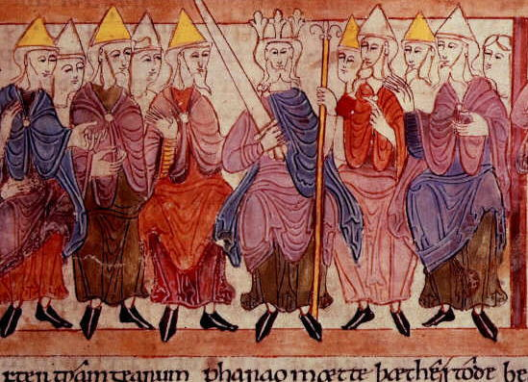
History of the Parliament
Anglo-Saxon king with his witan (11th century)
Related to Anglo-Saxon
tradition: witenagemot,
also known as witan
(from Old English witan = wise man
or counsellor + gemot = assembly )
13th century: process
of evolution of the
Parliament began with the Curia Regis, the king's feudal council to which he summoned his tenants in chief, the great barons, and the great prelates  House of Lords
13th century: occasional convocation of representatives of other social classes of the state - knights and burgesses - usually to report the counties’ and towns’ “consent” to taxes imposed by the king  House of Commons

Slide 6
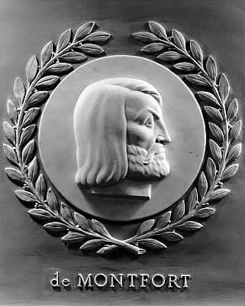
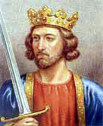
Simon de Montfort summoned representatives of the counties, towns, and lesser clergy in an attempt to gain support from the middle classes in his conflict with King Henry III. His famous Parliament of 1265 included two representative burgesses from each borough and four knights from each shire.
1295 - Edward I summoned the so-called Model Parliament (consisting of prelates, magnates, two knights from each county, two burgesses from each town, and representatives of the lower clergy)

Slide 7
14th century: the beginning of the present two-chamber system in England:
- the House of Lords (the upper house)
- the House of Commons (the lower house)
The Houses sit separately and are constituted on entirely different principles.
The relationship between the Houses is governed by convention and by the Parliament Acts.
The legislative process involves both Houses of Parliament and the Monarch.

Slide 8
FUNCTIONS
The main functions of the Parliament are to:
make all UK law
provide the means of carrying on the work of the government (through voting for taxation)
protect the public and safeguard the rights of individuals
scrutinise government policy and administration, including proposals for expenditure
examine European proposals before they become law
hear appeals in the House of Lords, the highest Court of Appeal in Britain
debate the major issues of the day.

Slide 9
THE HOUSES

Slide 10
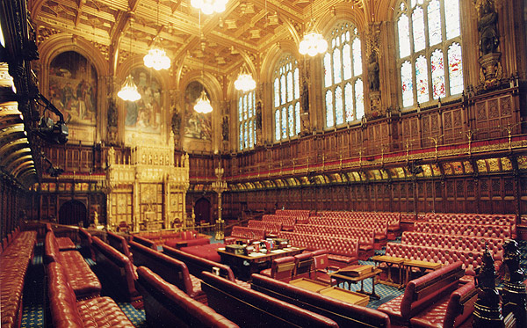
THE HOUSE OF LORDS
The House of Lords Chamber was designed by Charles Barry and Augustus Pugin after the fire of 1834. The ornate room is decorated in red and gold. At each end of the Chamber, there are three frescos representing Religion, Justice and Chivalry. The layout consists of red benches on three sides of the Chamber, with a table in the middle and the Throne and Woolsack at the southern end. The Chamber is where the Lords conduct much of their daily business.

Slide 11
The House of Commons
The House of Commons Chamber was rebuilt after it was damaged during the Second World War.
The new Chamber was built in a style that was in keeping with the Chamber that had been destroyed.
There are two sets of green benches opposite to each other (Government and Opposition MPs sit facing each other), with a table in the middle and the Speaker's Chair at northern end. The Chamber only has room for 437 MPs to sit down although there are 659 MPs in total.
Many of the objects in the Chamber, such as the Speaker's Chair, are gifts from Commonwealth countries.

Slide 12
Current State of the Parties:
Party | Seats
Conservative | 330
Labour | 231
Scottish National Party | 55
Democratic Unionist Party | 8
Liberal Democrat | 8
Sinn Fein | 4
Plaid Cymru | 3
Social Democratic & Labour Party | 3
Independent | 2
Ulster Unionist Party | 2
Green Party | 1
Speaker | 1
UK Independence Party | 1
Vacant | 1
Total number of seats | 650
Working Government Majority | 17
Nearly all MPs are members of political parties.
MPs who are not members of a political party are known as 'Independent‘.

Slide 13
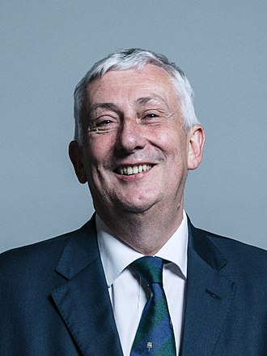
The Speaker of the House of Commons
chairs debates in the Commons chamber.
The holder of this office is an MP who has been elected to be Speaker by other MPs.
During debates they keep order and call MPs to speak.
The Speaker is the chief officer and highest authority of the House of Commons and must remain politically impartial at all times.
The current Speaker is
Sir Lindsay Hoyle (since 4 November 2019)

Slide 14
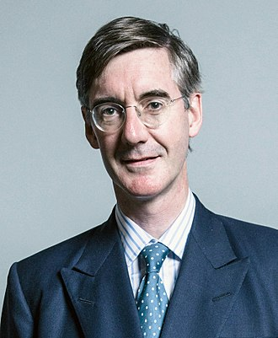
Leader of the House of Commons
Leader of the House of Commons; Lord President of the Council and Lord Privy Seal is a government minister and member of the Cabinet.
The main role of the Leader is organising government business in the Commons, through working closely with the government's Chief Whip.
Rt Hon Jacob Rees-Mogg MP
Assumed office on 24 July 2019
Website: www.commonsleader.gov.uk

Slide 15
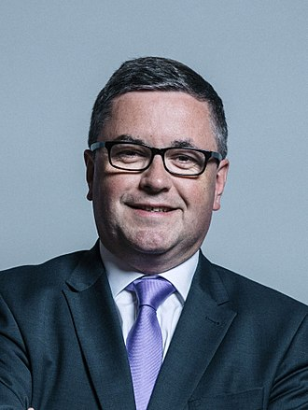
The Lord High Chancellor of Great Britain
The Lord Chancellor is a Cabinet minister and Secretary of State for Justice
He is currently a Member of the House of Commons.
Recent reforms in 2006 and 2007 have significantly altered the role of Lord Chancellor.
Rt Hon Robert Buckland QC MP
Assumed office on 24 July 2019

Slide 16
Ministry of Justice
On 9 May 2007, the Ministry of Justice was created.
The Ministry of Justice is responsible for courts, prisons, probation and constitutional affairs.
The Secretary of State for Justice and Lord Chancellor is the Rt Hon Elizabeth Truss PC MP.
A new Judicial Appointments Commission began to operate from 3 April 2006.
This ended the Lord Chancellor's past position as head of the judiciary (courts of law in England and Wales) and power to appoint judges.

Slide 17
Mace of the House of Commons
In the House of Commons the Mace is a symbol of Royal Authority.
It represents the power and authority that the monarchy has delegated to the House of Commons in the past.
The Mace lies on the Table in front of the Speaker when Members are debating.
The Mace is carried in and out of the chamber by the Serjeant at Arms in a procession at the beginning and end of each day.
Without the Mace in position, the House cannot sit and debate.

Slide 18
PARLIAMENTARY ARCHIVES
1497 – It was decided that the records of Parliament should be kept at Westminster, distinct from the archives of government
they have been kept there ever since.
This is the first of the Acts kept by the Hatton archives:
It concerns the taking of apprentices for making worsted (wool yarn)

Slide 19
Death warrant of King Charles I 1649
Charles I was placed on trial in January 1649. After four days of proceedings, his refusal to plead was judged to be a confession and on January 29th he was sentenced to death by beheading.
This document, authorising the execution of the death sentence, bears the signatures and seals of 59 of the commissioners who sat in judgement upon the king.

Slide 20
Articles of Union with Scotland 1707
The Articles of Union with Scotland were agreed on 22 July 1706.
They were approved by the Scottish Parliament and laid before the House of Lords for approval on 28 January 1707 (New Style).
An Act incorporating the articles was passed by the English Parliament the following March, and the union of the two kingdoms came into being in May 1707.
Articles I and II dealt with the union and confirmed the succession of the House of Hanover.
Article III established the Parliament of Great Britain.

Slide 21
Debate in the House of Commons
The main business in the House Commons Chamber often takes the form of a debate.
This includes debates on legislation, general topics of interest or issues selected by the major parties.

Slide 22
The Robing Room
The Robing Room is where the Queen prepares for the State Opening of Parliament. She puts on ceremonial robes and the Imperial State Crown. The Robing Room is located at the southern end of the Palace of Westminster.

Slide 23
The Royal Gallery
The Royal Gallery is adjacent to the Robing Room. Its walls feature two large frescoes by Daniel Maclise, The Meeting of Wellington and Blücher at Waterloo and The Death of Nelson. The room sometimes hosts foreign dignitaries addressing Parliament.

Slide 24
Passing of the House of Lords Act 1999
This day, 11 November 1999, was the last time all hereditary peers sat in the Lords.
The House of Lords Act 1999 was granted Royal Assent and came into force on 11 November 1999, the last day of the 1998-99 parliamentary session.
The Act removed the rights of all but 92 hereditary peers to sit in the House of Lords.

Slide 25
Speaker of the House of Lords
The Lord Speaker is a role elected internally by Members of the House of Lords.
Politically impartial, responsibilities of the Lord Speaker include chairing the Lords debating chamber, offering advice on procedure, and acting as an ambassador for the work of the Lords both at home and abroad.
Inaugural holder of the new title and office of Lord Speaker is Baroness Hayman

Slide 26
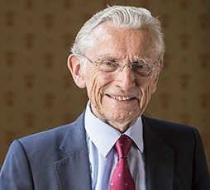
The Lord Speaker
The Lord Speaker is a role elected internally by Members of the House of Lords.
Politically impartial, responsibilities of the Lord Speaker include chairing the Lords debating chamber, offering advice on procedure, and acting as an ambassador for the work of the Lords both at home and abroad.
appointed for a five years term (renewable once)
Incumbent Lord Speaker:
The Rt Hon Lord Fowler; Assumed office on 1 September 2016
(Peter Normann Fowler, Baron Fowler)
House of Lords Phone: 020 7219 6444 London Email: lordspeaker@parliament.uk SW1A 0PW

Slide 27
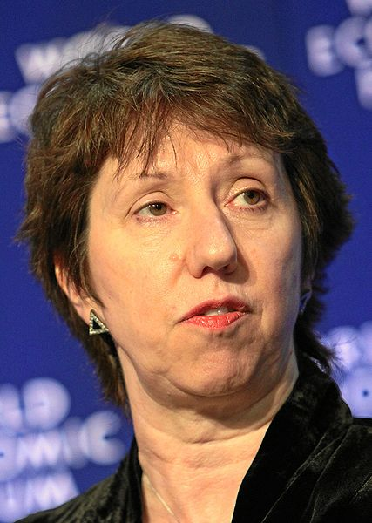
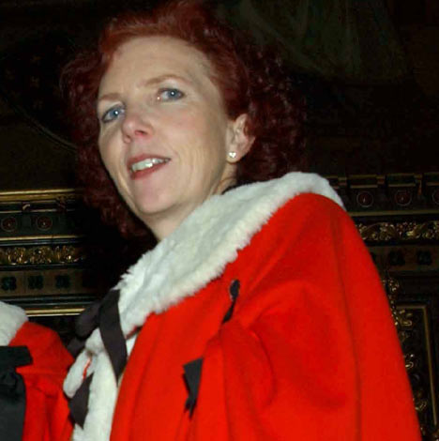
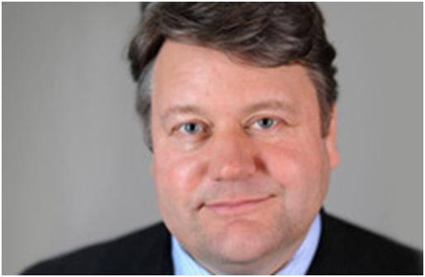
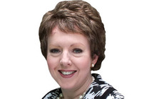
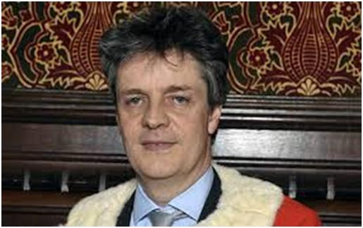
Leader of the House of Lords
The office was recently held by labourists:
Baroness Amos (October 2003 – June 2007)
Lady Ashton of Upholland (June 2007-Oct. 2008)
Janet "Jan" Anne Royall, Baroness Royall of Blaisdon (October 2008 – May 2010)
who were then succeeded by conservatives:
Thomas Galloway Dunlop du Roy de Blicquy Galbraith, 2nd Baron Strathclyde,
(May 2010 – January 2013)
Jonathan Hopkin Hill, Baron Hill of Oareford (January 2013 – 15 July 2014)
Tina Stowell, Baroness Stowell of Beeston
(15 July 2014 – 14 July 2016)

Slide 28
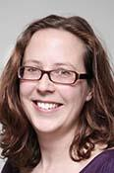
Leader of the House of Lords
The Leader of the House of Lords is a government minister and member of the cabinet.
The office is responsible for the organisation of government business in the House of Lords, and offering advice on matters of House procedure.
The incumbent Leader of the House of Lords is The Right Honourable Natalie Jessica Evans, Baroness Evans of Bowes Park
(assumed office on July 14, 2016)

Slide 29
Clerks in the Houses
While in the Commons chamber, the main duties of the Clerk of the House and his deputies are to formally record decisions of the House and give procedural advice to the Speaker or other MPs as needed.
While in the Lords Chamber, the main duties of the Clerk of the Parliaments and his deputies are to formally record decisions of the House and give procedural advice to Members of the House of Lords as needed.

Slide 30
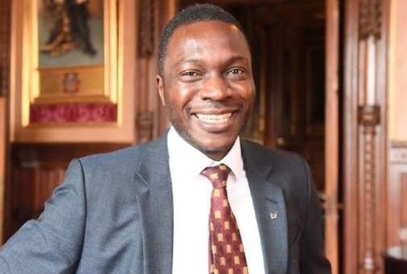
Serjeant-at-Arms
responsible for security matters concerning the House of Commons
keeps order during the meetings of the House of Commons
escorts MPs out of the chamber by order of the Speaker of the House
Guards the Mace of the House and carries it during ceremonies for the Speaker of the House
Ugbana Oyet - Serjeant at Arms since 27 October 2019
Jill Pay – the first woman appointed to the role of Serjeant-at-Arms of the British House of the Commons, and the first person recruited from the civil service rather than the police or military

Slide 31
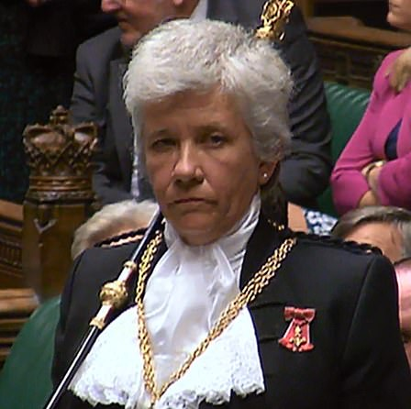
Gentleman Usher of the Black Rod
senior officer in the House of Lords.
responsible for security, controlling access to and maintaining order within the House and its precincts.
summons the Commons to attend the speech and leads them to the Lords.
Part of the ritual :
as Black Rod approaches the doors to the chamber of the House of Commons to make his summons, they are slammed in his face. This symbolizes the Commons' independence of the Sovereign.
Black Rod then strikes the door three times with his staff, is then admitted and issues the summons of the monarch to attend.
Sarah Clarke
The Lady Usher of the Black Rod
since 13 February 2018

Slide 32
Robing Room – the Throne
The Robing Room is where the Queen prepares for the State Opening of the Parliament.
She puts on ceremonial robes and the Imperial State Crown. The Robing Room is located at the southern end of the Palace of Westminster.

Slide 33
House of Lords Chamber: the Throne
The House of Lords Chamber was designed by Charles Barry and Augustus Pugin after the fire of 1834.
The ornate room is decorated in red and gold. The throne sits at the southern end.
The Queen sits on this throne at the State Opening of Parliament to deliver the Queen's Speech which sets out Parliament's business for the coming year.

Slide 34
How Does the Parliament Work?
Parliament links on the Internet:
http://www.parliamentlive.tv/Main/VideoPlayer.aspx?Film=TheGeneralElectionExplained&w=320&h=180
http://www.parliament.uk/commons/index.cfm
http://www.parliament.uk/lords/index.cfm

Slide 35
UK Representation
The UK Parliament has MPs from areas across England, Scotland, Wales and Northern Ireland.
Devolved Parliaments and Assemblies
In addition, there is a Parliament in Scotland, a National Assembly in Wales and a (currently suspended) National Assembly in Northern Ireland.
Separate elections are held for these devolved political bodies
candidates who win seats in these elections do not become MPs in the UK Parliament

Slide 36
Who Can Stand as an MP?
Candidates must be:
British citizens (or citizens of a Commonwealth country or the Republic of Ireland)
over 21 years of age
nominated by ten parliamentary electors of the constituency they wish to stand in
authorised to stand for a specific party
independent or have no description if not representing a party
pay a £500 deposit when submitting the nomination papers (to encourage only serious candidates to stand; deposits are returned if the candidate receives over five per cent of the total votes cast)
Certain people are disqualified from standing as an MP - please check the Electoral Commission website for further details.

Slide 37
Who Cannot Be a Candidate?
The following are disqualified from sitting in the House of Commons:
- peers who sit in the House of Lords;
- bishops (Lords Spiritual) who sit and vote in the House of Lords;
- undischarged bankrupts;
- holders of judicial office
- civil servants;
- members of the armed forces or police forces;
- members of legislatures of countries/territories outside the Commonwealth;
- Government-nominated directors of commercial companies;
- prisoners - (persons found guilty and sentenced to more than 12 months imprisonment are disqualified while detained in the UK, the Channel Islands, the Isle of Man or the Republic of Ireland);
- people found guilty of electoral offences (e.g. corrupt or illegal practices).
There is also a common law rule that
- ‘idiots’ are disqualified for election to Parliament and that
- ‘lunatics’ are disqualified in their non-lucid intervals

Slide 38
How Are MPs Elected?
The UK is divided into 646 constituencies.
General elections generally happen every four to five years.
During an election, constituents (everyone eligible to cast a vote) in a constituency select one candidate to be their MP.
The candidate who gets the most votes becomes the MP for that area until the next election.
If an MP dies or retires, an election is held in that constituency alone to find a new MP for that area.

Slide 39
What Do MPs Do?
Work in the Parliament
Work in the constituency
Work for the political party

Slide 40
MPs’ Work in the Parliament
represent the interests and concerns of the public in the House of Commons
consider and propose new laws
ask government ministers questions about current issues in the country.
raise questions about issues affecting their constituents,
attend debates
vote on new laws
work in committees analyzing
government policy
new laws
wider topics (e.g. human rights)
etc.

Slide 41
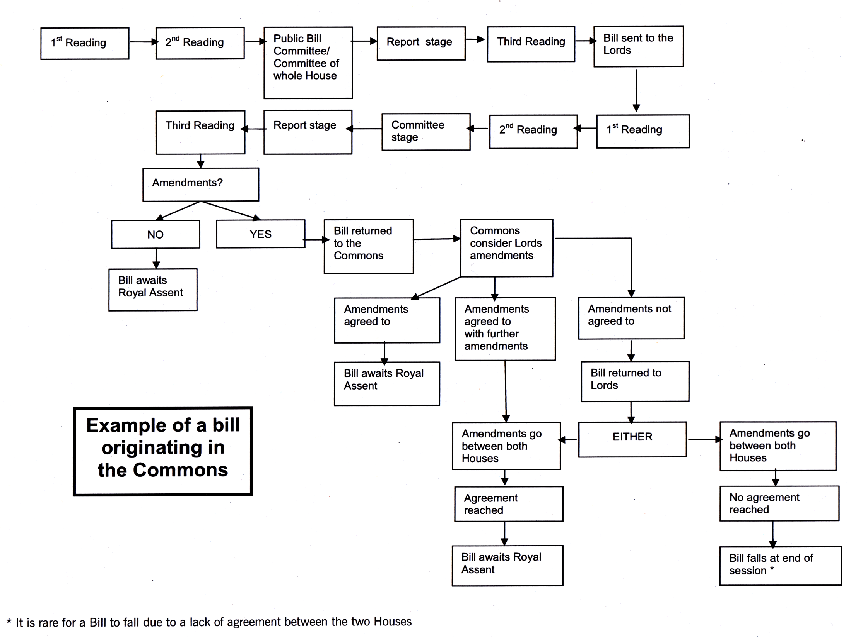

Slide 42
Working in Their Constituency
hold a 'surgery' in their office (where local people can come to discuss any matters that concern them)
attend functions
visit schools and other institutions and businesses
try to meet as many people as possible (to gain further insight into issues they may discuss when they return to Westminster).

Slide 43
Work in Political Parties
Most MPs are members of one of the three main political parties in the UK
- Labour
- Conservative
- Liberal Democrat
Other MPs represent smaller parties, or are independent of a political party.
To become an MP representing a main political group, a candidate
- must be authorised to do so by the parties nominating officer
- must then win the most votes in his/her constituency

Slide 44
What Lords Do
The Lords work in Parliament’s second chamber – the House of Lords.
They:
complement the work of the House of Commons.
participate in the making of laws
act as the supreme court of appeal (Law lords)
check the work of the government (by questioning and debating decisions made by Ministers and government departments)
work in Specialist committees (relating to Europe, science and technology, economics, the constitution and other if needed)

Slide 45
Types of Lords
Life Peers
- appointed by the Queen on the advice and recommendation of the
Prime Minister for their lifetime only,
- their Lords’ titles are not passed on to their children.
Law Lords (or Lords of Appeal in Ordinary)
- salaried, full-time judges who carry out the judicial work of the
House of Lords.
- The Queen appoints them on the recommendation of the Prime
Minister, who receives advice from the Lord Chancellor
(this method of appointment has changed in 2007 with the beginning
of the work of the independent Judicial Appointments Board).
- Candidates usually come from serving judges of the Court of Appeal
in England and Wales, the Court of Session in Scotland, and the
Court of Appeal in Northern Ireland.

Slide 46
Archbishops and Bishops
- a limited number of twenty-six Church of England
archbishops and bishops sit in the House, passing
their membership on to the next most senior bishop
when they retire.
Elected Hereditary Peers
- the right of hereditary peers to sit and vote in the
House of Lords was ended in 1999 by the House of
Lords Act but 92 Members were elected internally
to remain until the next stage of the Lords reform
process.

Slide 47
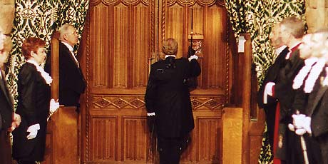
State Opening of the Parliament
The Black Rod knocking at the doors of the House of Commons to summon the Commons to attend the Queen’s Speech
The Black Rod and the Speaker of the House of Commons lead the Commons to the House of Lords (House of Peers) to hear the Queen’s Speech

Slide 48
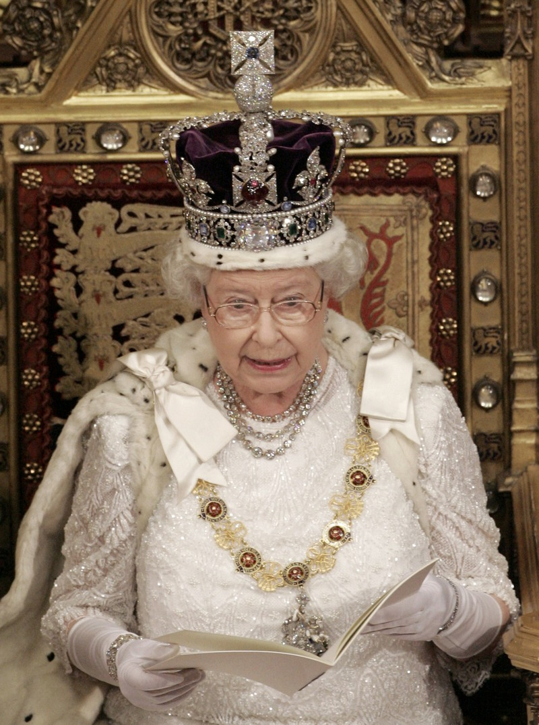
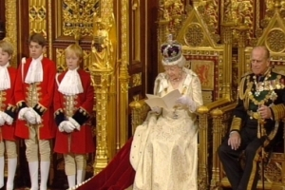
Speech from the Throne / The Queen’s Speech
The Queen's Speech is delivered by the Queen from the Throne in the House of Lords, in the presence of Members of both Houses.
Although the Queen reads the Speech, the content is entirely drawn up by the Government and approved by the Cabinet. It contains an outline of the Government's policies and proposed new legislation for the new parliamentary session.
https://www.youtube.com/watch?v=KA2SJoOgRSQ

Slide 49
Some Useful Links
Companion to the Standing Orders and Guide to the Proceedings of the House of Lords
http://www.parliament.the-stationery-office.co.uk/pa/ld/ldcomp/compso.pdf
House of Commons The Code of Conduct and Guide to Rules
http://www.publications.parliament.uk/pa/cm200809/cmcode/735/735.pdf
Standing Orders of the House of Commons
http://www.publications.parliament.uk/pa/cm200809/cmstords/2/2.pdf
https://www.youtube.com/watch?v=BLwV2P26QCY

