Slide 1
THE LEGAL PROFESSION IN ENGLAND

Slide 2
Revision
What types of precedent are there? What is the difference between them?
What does it mean to follow the precedent and when is this done?
What does it mean to distinguish the case?

Slide 3
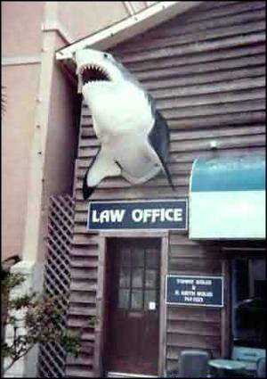
Why do people “love” lawyers so much?

Slide 4
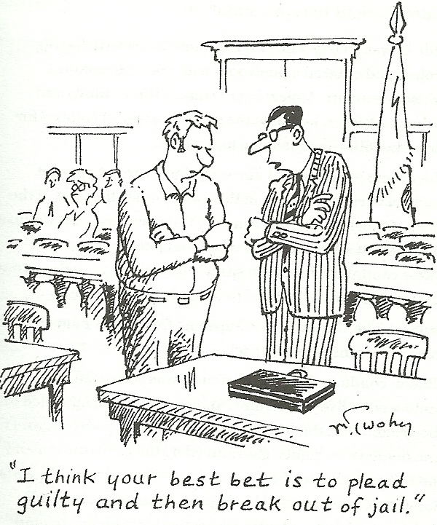
What can lawyers do for their clients?

Slide 5
Lawyers are peace-loving individuals who impress clients with their honesty, integrity, dedication and determination to solve conflicts peacefully. Is this why clients trust them?

Slide 6
Why would anyone want to be a lawyer?

Slide 7
Overview
Branches of the legal profession
Solicitors: type of work
Solicitors’ professional organisation
Solicitors’ training
Barristers: type of work
Barristers’ professional organisation
Barristers’ training
Advantages and disadvantages of a split profession
Historical overview
Legal terms

Slide 8
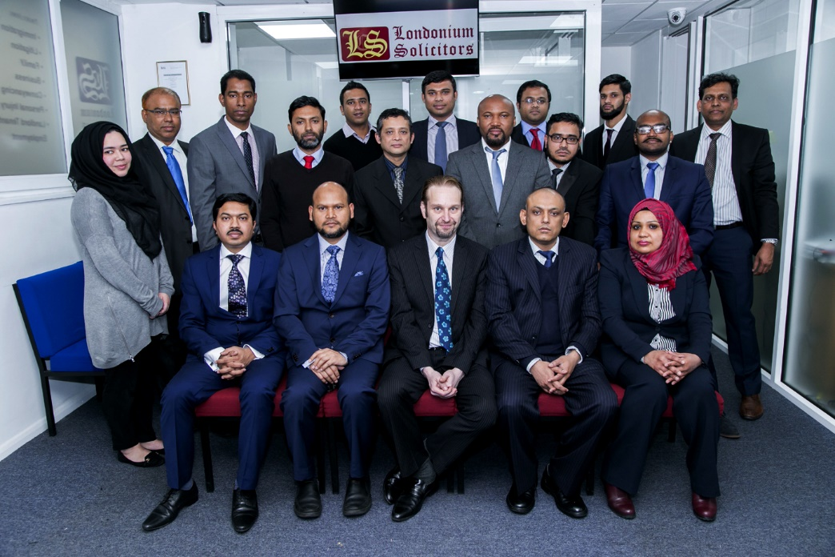
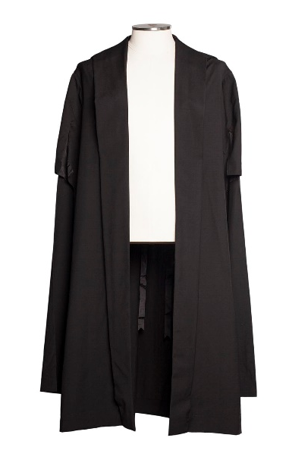
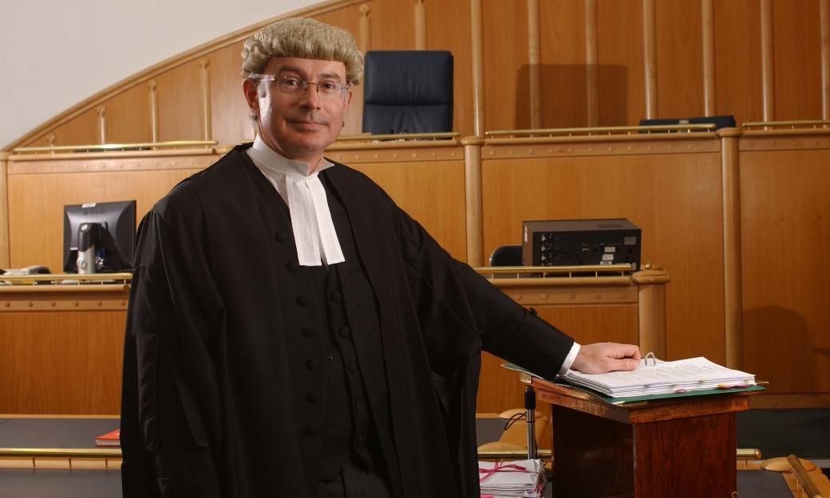
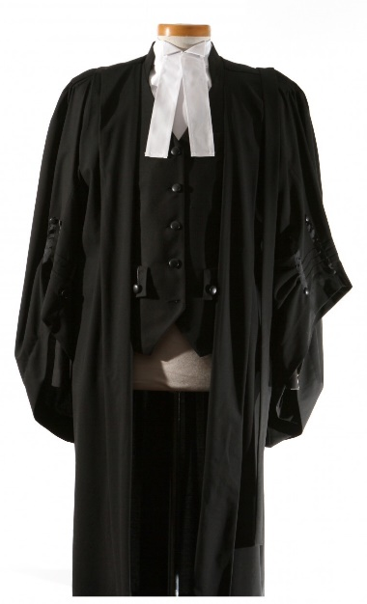
Branches of the legal profession
solicitors
barristers

Slide 9
Solicitors
- Work on their own, or as partners with other solicitors
- A solicitor’s practice: firm of solicitors
Provide members of the public → clients with skilled advice and representation in all legal matters
Take instructions from clients
In more difficult cases and those to be tried at a higher court write briefs and approach barristers

Slide 10
The Legal Profesion in England
There are two branches of the legal profession in England, two types of legal practitioners representing clients:
SOLICITORS
BARRISTERS
They have different training, functions, responsibilities, areas of expertise and rights
In history, each type of attorney enjoyed various exclusive rights, but this has been gradually abolished since 1985

Slide 11
Education of lawyers
1a. University degree in law
(LLB – Bachelor of Legal Letters)
usually a three-year programme
OR
1b. A bachelor’s degree (BA) in any subject
+
Graduate Diploma in Law (GDL)
a one-year conversion course

Slide 12
Education of lawyers
After completing an LLB or a GDL programme:
2a. Legal Practice Course (LPC) – for solicitors
OR
2b. Bar Professional Training Course (BPTC) – for barristers
both are one-year programmes, but can sometimes be taken over the course of two years

Slide 13
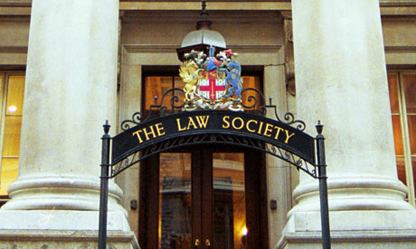
Solicitors

Slide 14
Solicitors
primarily thought of as lawyers who can be contacted directly by members of the public
direct contact with lay clients – people seeking legal advice or legal representation
traditionally have the right of audience only in inferior courts
generally perceived as general practitioners

Slide 15
The Court System

Slide 16
Solicitors
investigate the facts of the case, do the ‘legwork’
collect evidence, talk to witnesses, have contact with the police where necessary
prepare briefs for barristers (all relevant documents and evidence necessary for trial)
if the case needs to be tried at a higher court, they will instruct a barrister

Slide 17
Solicitors
they also do non-contentious work, which refers to legal services which do not involve a court procedure
E.g. conveyancing (prijenos prava vlasništva), drafting contracts and wills (sastavljanje ugovora i oporuka)
intermediaries between lay clients and barristers

Slide 18
Solicitors
Usually work in partnerships or incorporated law firms, sometimes employing a large number of solicitors
This allows them to specialize in a certain field of the law, such as: commercial law, conveyancing, family law, probate (ostavina), employment, criminal law, accidents and personal injury, consumer protection, etc.

Slide 19
Solicitors
Have the right of audience before lower (inferior) courts: magistrates’ courts and county courts
May qualify for an advocacy certificate in the higher courts (this is a recent change, which reduces the gap between solicitors and barristers)
SOLICITOR ADVOCATE

Slide 20
Becoming a solicitor
After obtaining a law degree (LLB), future solicitors take a one-year Legal Practice Course (LPC)
Upon completion they look for a training contract
Serve two years as a trainee in a firm of solicitors
In order to practise law, solicitors must obtain an annual practising certificate issued by the Law Society

Slide 21
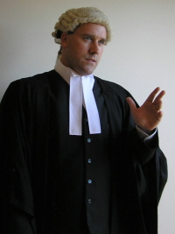
Barristers

Slide 22
Barristers
Barristers are professional advocates – act as legal representatives (in criminal cases both for the defense and the prosecution if employed by the Crown Prosecution Service – CPS)
Their work also involves drafting documents associated with court procedure, and giving specialist legal advice
Traditionally, barristers have had the right of audience in the higher courts
Referred to as ‘counsel’ in the court of law

Slide 23
Barristers
Not allowed to form partnerships, but rather work as sole practitioners
May share clerks, so that if one barrister is busy, another may replace him
Usually specialize in a certain area of the law
Their clients are solicitors. They do not usually have direct contact with lay clients.

Slide 24
Becoming a barrister
After obtaining a law degree (LLB), future barristers attend a Bar Professional Training Course (BPTC)
As students, after making a certain number of attendances, i.e. dinners (referred to as ‘keeping terms’), they are called to the Bar by one of the Inns of the Court (barrister associations of medieval origin)

Slide 25
Becoming a barrister
The Inns used to be institutions providing training in common law to barristers. Today they are unincorporated institutions run by their senior members
There are four Inns of the Court: Gray’s Inn, Lincoln’s Inn, Inner Temple and Middle Temple
Their function today is to recruit and train new barristers

Slide 26
Inner Temple

Slide 27
Middle Temple

Slide 28
Grey’s Inn

Slide 29
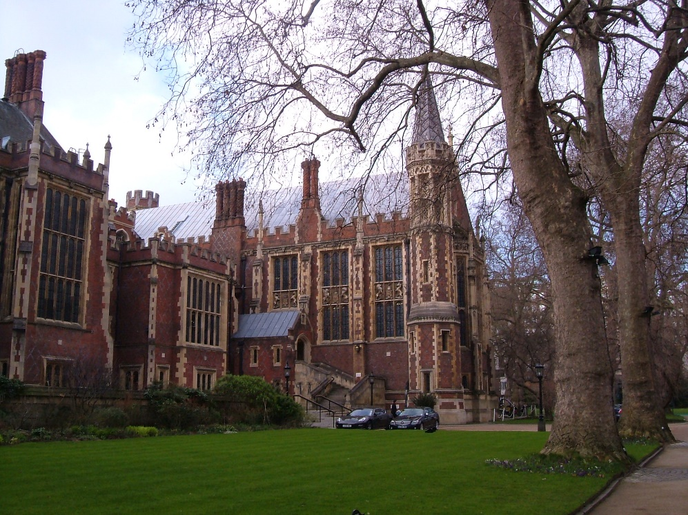
Lincoln’s Inn

Slide 30
Becoming a barrister
The new barrister then competes to obtain a funded 12-month pupillage in chambers to get practical training
PUPILLAGE – a non-practising six months (observation of professional activities under a pupil master) and a practising six months (supply of legal services and exercise of the right of audience).

Slide 31
Becoming a barrister
To gain a Full Qualification Certificate pupils must learn the rules of conduct and etiquette at the Bar, learn to prepare and present a case completely, etc.
The Certificate is issued by the Bar Council
If successful at pupillage, they can apply for a tenancy in chambers
Tenants share common expenses and support services at their chambers at one of the Inns

Slide 32
Advancement of lawyers
Years of experience as either a solicitor or a barrister is a prerequisite for becoming a judge
Two levels of barristers: Junior Counsel and Queen’s Counsel (“Silks”)

Slide 33
Advancement of lawyers
All practising barristers are junior counsel until or unless they have been designated Queen’s Counsel (QC)
Minimum 10 years of standing (in practice 15)
Solicitors can also apply to become QCs

Slide 34
Advancement of lawyers
QCs expected to appear only in the most complex and important cases, but are always accompanied by at least one junior counsel
QCs also known as Silks, as they wear a silk gown (not black like junior counsel)
QCs enjoy privileges (sit closest to the judge and have the right to address the judge first) and are paid significantly higher fees

Slide 35
The ‘Silk’ System
The Silk system is criticized because it does little to improve legal services
Only 10% of the Bar are QCs and many able barristers never advance
Engaging a QC is hardly a guarantee of success
Most barristers motivated to apply for the sake of prestige and significantly higher earnings
Impedes a system of ‘free market’ in the field of advocacy – QCs thought to have an unfair advantage

Slide 36
Two professions – pros and cons
ARGUMENTS IN FAVOUR OF FUSION
Expense to the client
Failures in communication between solicitor and barrister
A selected barrister may be too busy at a given moment so the solicitor has to hire another, sometimes at the last minute

Slide 37
Two professions – pros and cons
ARGUMENTS AGAINST FUSION
Barristers free from interruptions by clients; easier for them to detach themselves
Barristers can focus on special skills needed for public speaking, addressing the judge and the jury, which eventually benefits the lay client – preserves the quality of advocacy

Slide 38
Vocabulary work
Complete the table with the words from the same family
VERB | NOUN | NOUN (person)
partner | partnership | partner
 |  | trainee
advise
 | practice
specialise | -

Slide 39
Vocabulary work
Complete the table with the words from the same family
VERB | NOUN | NOUN (person)
Partner | Partnership | Partner
Train | Traineeship/ Training | Trainee
Advise | Advice | Adviser
Practise | Practice | Practitioner
Specialise | Specialism / Specialization / Special(i)ty | Specialist

Slide 40
Watch the video clips
Solicitor or Barrister? Students’ opinions (2:14)
https://www.youtube.com/watch?v=f1IstxhV2JU
How to Become a Solicitor (6:37)
https://www.youtube.com/watch?v=OZDEsYZMpMw
Spotlight on: Becoming a Barrister (2:14)
https://www.youtube.com/watch?v=DVBYmfItyCk

Slide 41
An Insight into the Inner Temple:
https://youtu.be/ZkOsOwDPyAU
Inns of Court Scholarship Interviews:
https://youtu.be/hBxz2KQ2tZk

Slide 42
Additional information
Barristers:
www.barcouncil.org.uk
Solicitors:
www.lawsociety.org.uk/home.law
International professional organisations
www.ibanet.org

Slide 43
Inns of Court
https://www.youtube.com/watch?v=R80ZjoyLMkA

