Slide 1
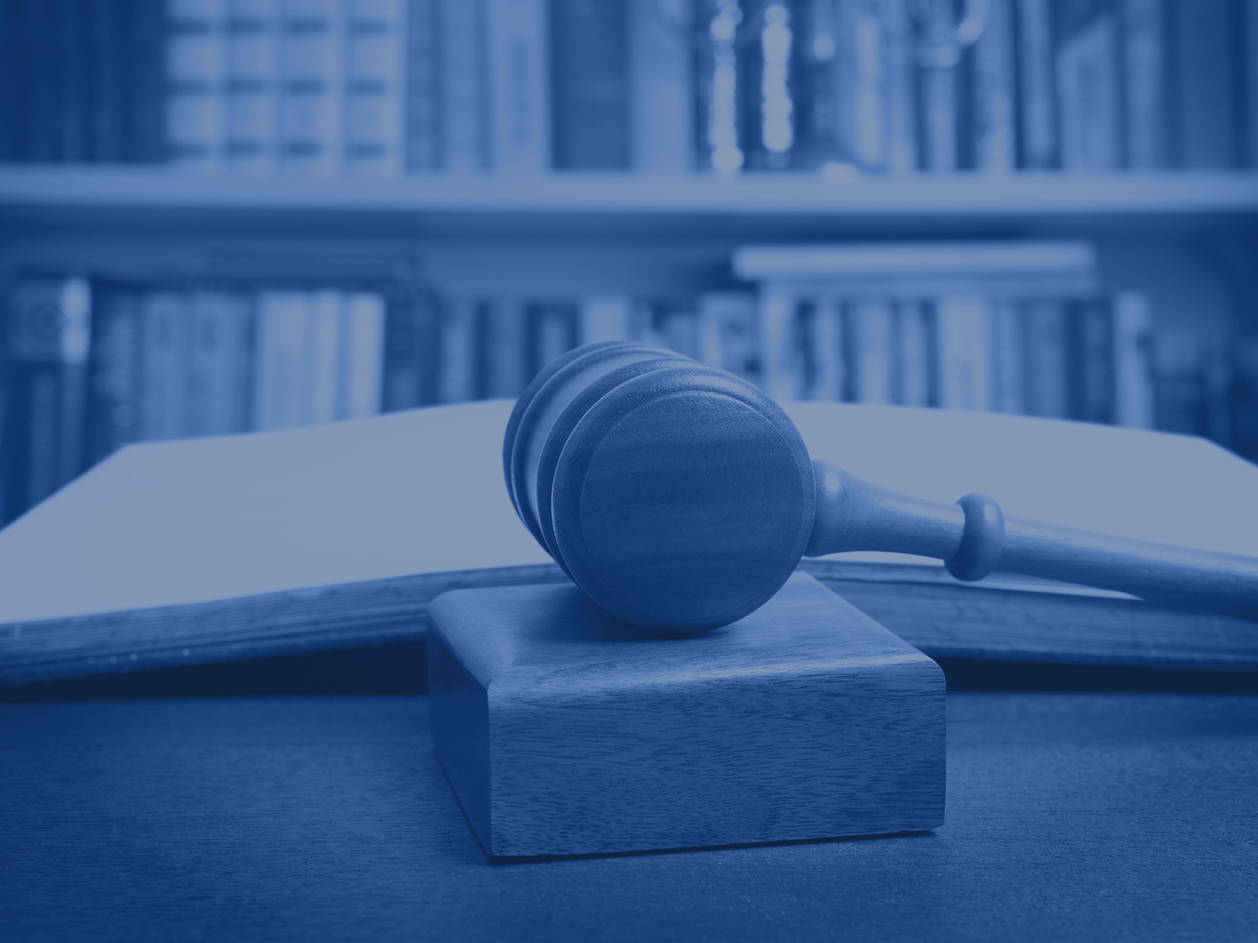
The Doctrine of Precedent

Slide 2
Revision
Outline the system of civil courts in the UK.
Outline the system of criminal courts in the UK.
Who are justices of the peace?
What was the highest court in the UK before 2009?
Who is responsible for judicial appointments?
Naslov predavanja
Autor predavanja
2

Slide 3
Precedent
A previous decision made by a superior court on similar facts - the rule of precedent requires that in certain circumstances a decision made on a legal point made in an earlier case must be followed
The doctrine of precedent (stare decisis)
The hierarchy of courts
Naslov predavanja
Autor predavanja
3

Slide 4
The doctrine of precedent
Stare decisis :
the doctrine of judicial precedent is based on stare decisis abiding by a previous decision. / Once a point of law has been decided in a particular case, that law must be applied in all future cases with the same material facts. /
The doctrine is:
- All courts are bound to follow decisions made by their superior courts (courts above them);
- Appellate courts are normally bound by their own past decisions

Slide 5
How can a precedent be treated?
The counsels and the judge can:
CITE a precedent, a case – bring a precedent to the attention of the court
FOLLOW a precedent – establish that the principles applied in the precedent correspond to the case in hand and abide by the precedent
DISTINGUISH THE CASE – find that the facts of the case are different and that the same principles, i.e. precedent cannot or should not be applied
How does the doctrine of precedent work?
Judges are required to follow the decisions made in previous cases.
By doing so, they secure a consistency in the law .
Also, people referring their cases to law can make an educated guess about the likely outcome of their case (i.e. about their potential success )
Naslov predavanja
Autor predavanja
5

Slide 6
The Hierarchy of Courts
- relationship of mutual superiority/inferiority
between courts within the same branch
- there may also be equality between courts of
the same level within the same branch but the
judges in these courts are also expected to
follow each other’s precedents and to explain
their decision not to do so.
- when a point of European Law is involved, the
decisions of the European Court of Justice are
binding on all courts in England and Wales
- the House of Lords used to be the highest court
in England and Wales; since 1 October 2009 it is
the Supreme Court of the United Kingdom

Slide 7
The Hierarchy of Courts (cont.)
- when a point of European Law is involved, the
decisions of the European Court of Justice are
binding on all courts in England and Wales
- the House of Lords used to be the highest court
in England and Wales;
- since 1 October 2009 this role was assumed by
the Supreme Court of the United Kingdom

Slide 8
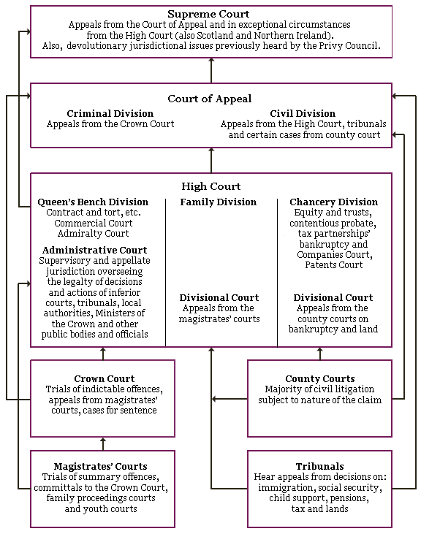

Slide 9
Types of precedents
Original
Declaratory
Binding
Persuasive

Slide 10
Original Precedent
If there is no previous decision on a point of law that has to be decided by a court, the decision made in that case on that point of law is viewed as an original precedent
When it needs to form an original precedent, the court will reason by analogy (in principle, it would consider the cases nearest to that being tried)

Slide 11
Declaratory precedent:
the judges in the case used as precedent merely
declared what the law has always been
- declaratory theory of law making
William Blackstone, “… judges do not create or
change laws. They simply discover and declare
what the law has always been.”
i.e. case law operates retrospectively since the law, as declared, has always existed.
Naslov predavanja
Autor predavanja
11

Slide 12
Binding Precedent:
A past decision is binding if:
the legal point involved is the same as the legal
point in the case that is being decided
the earlier decision was made by a court superior to the present court, or by a court at the same level which is bound by its own past judgments
the point was argued in the case

Slide 13
Persuasive Precedent:
a precedent that will be considered by the court
and by which the court may be persuaded, but
which the court does not have to follow, e.g.
- obiter dicta,
- a dissenting judgment, or
- ratios from decisions by inferior courts (courts that are lower in the hierarchy)
Naslov predavanja
Autor predavanja
13

Slide 14
Law Reports
The reasons for decisions of past cases must be properly recorded in order for the precedent system to operate effectively.
From 1537 to 1863 various private law reports were used.
Since 1863 the Incorporated Council of Law Reporting has been producing the official law reports.
Judgments of superior courts are available on their official sites on the Internet
Naslov predavanja
Autor predavanja
14

Slide 15
Ratio decidendi
Ratio decidendi = the reason for the decision
principles of law essential to the decision at hand.
- It is also defined as:
“any rule expressly or impliedly treated by the judge
as a necessary step in reaching his conclusion”.
15

Slide 16
Ratio decidendi (cont.)
The functioning of the doctrine of judicial precedent rests
on the possibility to determine what a point of law is.
While delivering a judgment, judges set out their reasons for reaching a decision. These reasons on which judges base their decisions are called the ratio decidendi of the case.
Ratio decidendi forms the legal principle that becomes a binding precedent. This precedent must then be followed in all future cases with the same (or similar) material facts.
16

Slide 17
Obiter dicta
Statements in passing (‘things said by the way’)
Statements of principles of law not relevant to the
decision in the case
Although not relevant, they can be persuasive
Naslov predavanja
Autor predavanja
17

Slide 18
Options for Avoiding the Precedent
Judges may avoid to follow a previous precedent by:
Overruling = a court higher in the hierarchy departs
from a decision made in a lower court.
The previous decision is no longer binding.
Reversing = a higher court departs from the decision
of the lower court on appeal.
Distinguishing = the facts of the case are deemed suf-
ficiently different so that the previous
case is no longer binding

Slide 19
Arguments in Favour of the
Doctrine of Precedent
Time saving
Certainty
Justice
Consistency
Flexibility
Naslov predavanja
Autor predavanja
19

Slide 20
Arguments Against the Doctrine
Promotes laziness
Stagnation
Backwards looking
Difficult to remedy mistakes
Naslov predavanja
Autor predavanja
20

Slide 21
Vocabulary
Binding precedent – obvezujući presedan
Persuasive precedent – preporučljivi presedan
Precedent law – pravo riješenih slučajeva
Divisional courts – sudski odjeli Visokog suda
Law Reports – zbirka sudskih odluka
Dissenting judgment – nejednoglasna sudska odluka
(odluka uz izdvojeno mišljenje)
Ratio decidendi – razlog za donošenje odluke
Obiter dicta – usputne primjedbe

